Slide 2
“And He gave some as apostles, and some as prophets, and some as evangelists, and some as pastors and teachers, for the equipping of the saints for the work of service, to the building up of the body of Christ; until we all attain to the unity of the faith, and of the knowledge of the Son of God, to a mature man, to the measure of the stature which belongs to the fullness of Christ.”
Ephesians 4:11-13

Slide 3
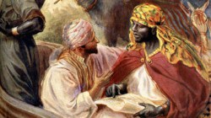
Then Philip ran up to what the chariot and heard the man reading Isaiah the prophet. “Do you understand you are reading?” Philip asked.
Acts 8:30

Slide 4
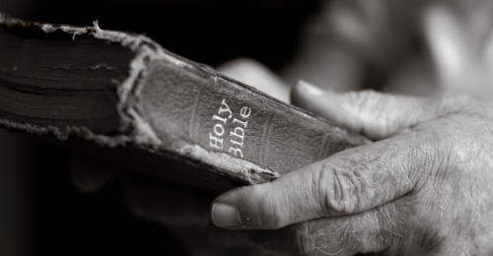
This bestowal of Evangelism must have these certain qualities:
Power from Heaven:
Presentation:
Persuasion:
Persistence:

Slide 5
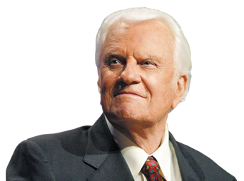
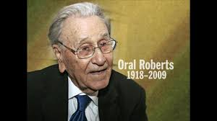
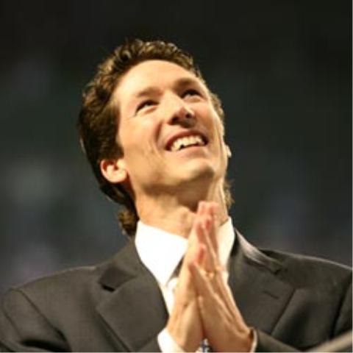

Slide 6
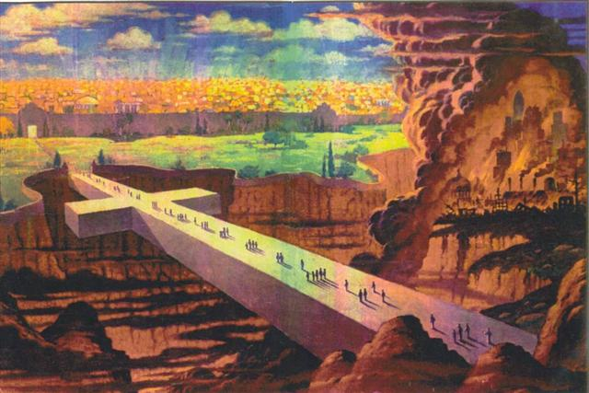
WHAT IS YOUR SALVATION STORY?

Slide 7
Open your eyes!
Get to Work!

