Slide 2
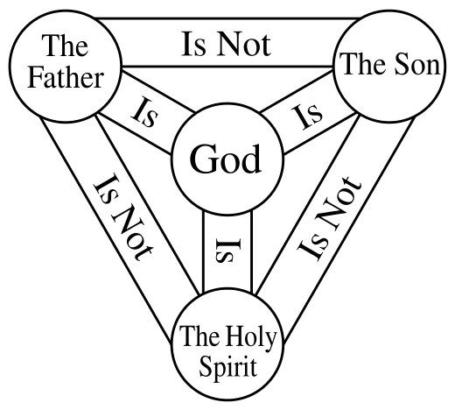

Slide 5
To get this ‘filling’ and to come to the intimate knowledge of Spirit, there are a few things to consider.
Christians are to cultivate a True Attitude of Submission
Christians must cede The Right of Signatory
The Mind, Eyes and Ears Must Be Aligned To Holy Spirit
Hunger for Spirit Must Be Cultivated

