Slide 1
Blessing Sunday
Grace | Bible | Church
God’s Grace Alone
The Word made Perfect
Ministers of God
Grace - 1

Slide 2
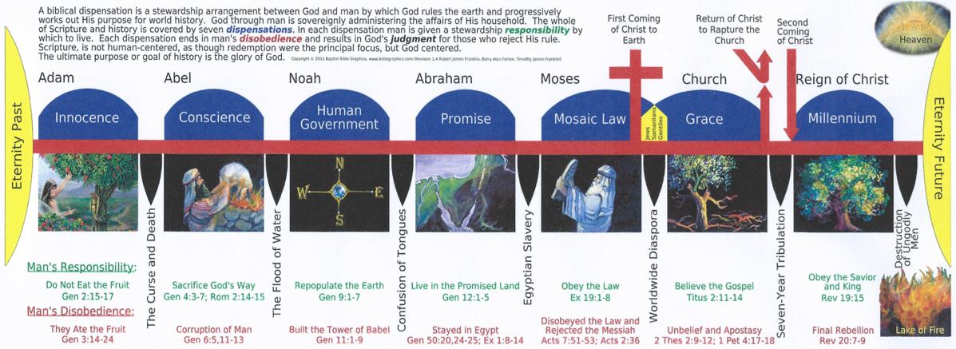
Dispensations in the Bible
For
Everyone
Created in God’s Image
For
Everyone
Created in God’s Image
For
Everyone
Created in God’s Image
For
Jews
Abraham and the Circumcised
For
Jews
The Circumcised
For
Everyone
Created in God’s Image
For
Jews
That didn’t take the mark of the Beast
--------------------------------------
--------------------------------------
--------------------------------------
Past
Past
Present
Future
Starting with Dispensation of Promise,
Go to next slide Grace-3: Jewish – Christian Dispensations
Grace - 2

Slide 3
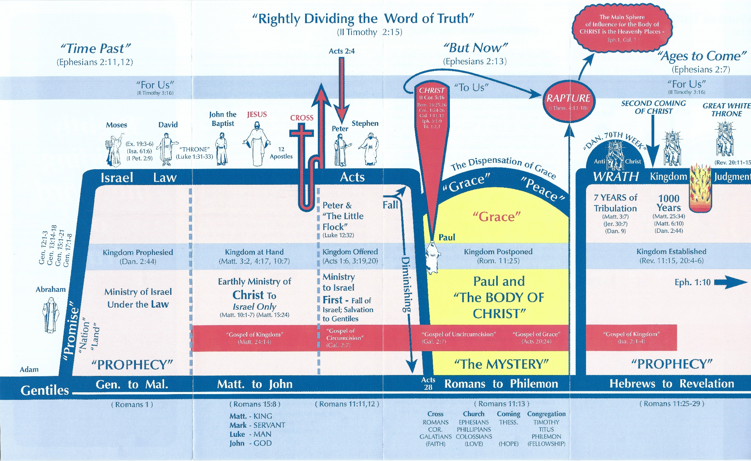
Jewish – Christian Dispensations
Dispensation of Law
New Heavens and New Earth
(Eph 1:10, Rev 21:1, 21:4, 2 Peter 3:13)
Dispensation of Promise
--------------------------------------
--------------------------------------
Dispensation of
Kingdom Realized
Dispensation of Grace
Jewish Past
Christian Present
Jewish Future
Grace - 3

Slide 4
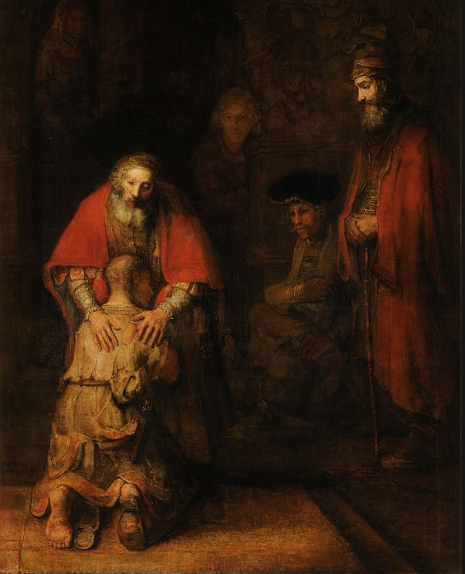
From the Creation of Adam and Eve
Through the Great White Throne Judgement
IT IS UP TO EACH OF US
Grace - 4

Slide 5
Grace - 5

Slide 6
Where Would We be Without GOD ???
Grace - 6

Slide 7
Blessing Sunday
Grace | Bible | Church
God’s Grace Alone
The Word made Perfect
Ministers of God
Grace - 7

