Slide 2
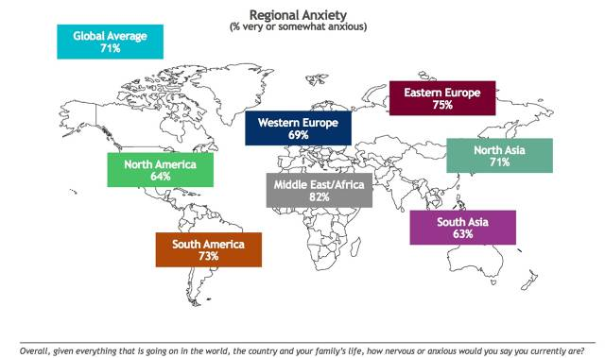

Slide 4
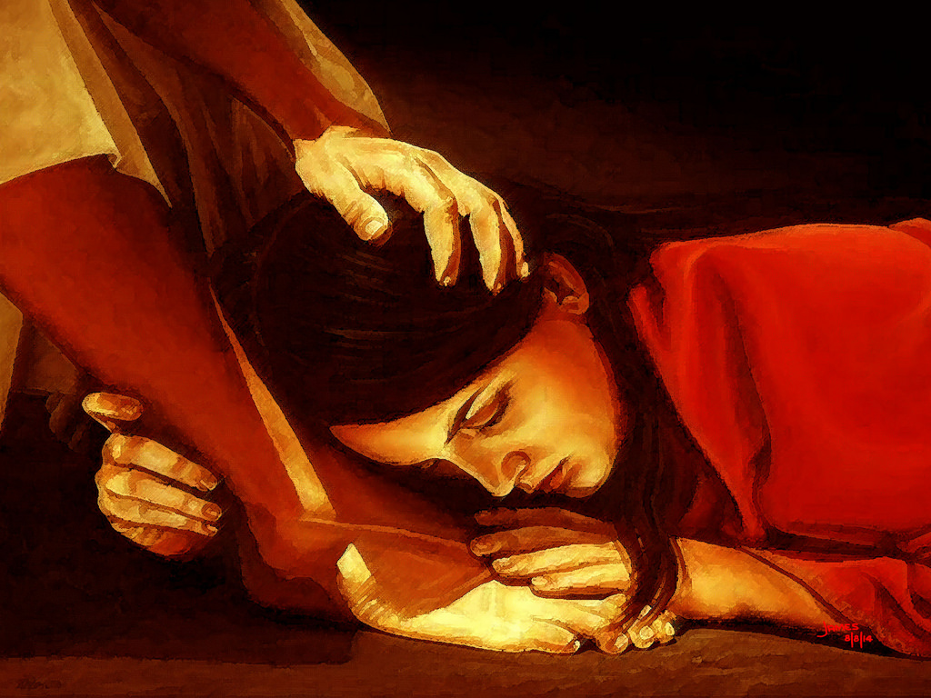

Slide 5
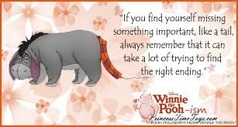

Slide 6
But as I’ve aged in the faith I’ve come to realize three important reasons why our apprehensions remain after we’ve we sought the Lord’s interventions.
We lose our patience!
We believe it should work out our way!
We don’t have confidence in His
empowering Spirit abiding!

Slide 7
