Slide 2
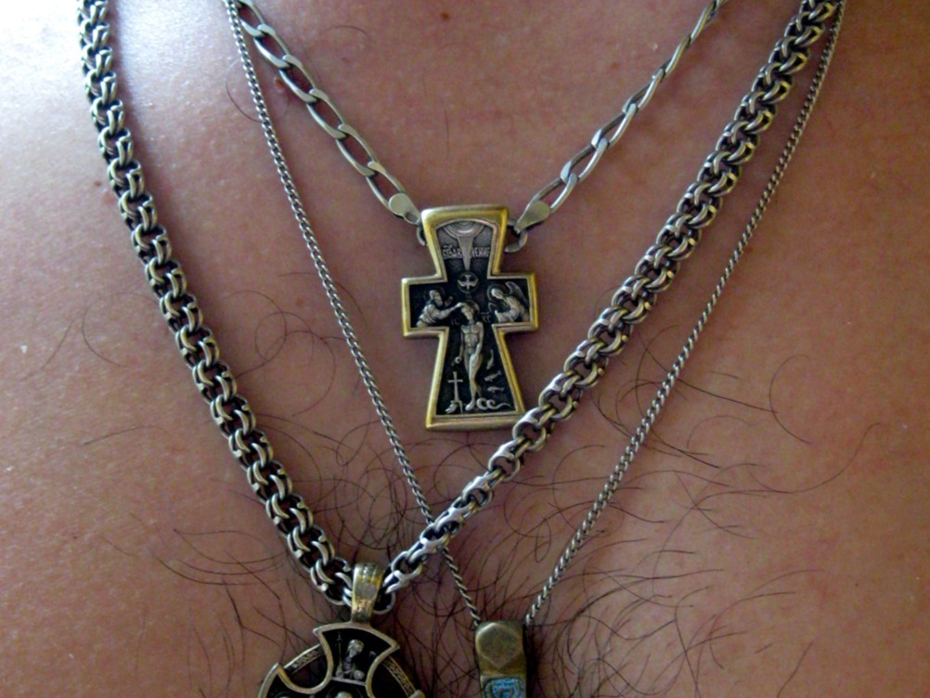

Slide 3
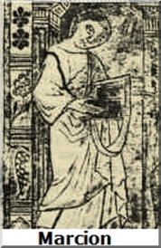
“Marcion of Sinope, a bishop of Asia Minor viewed the church of 130 as largely an Old Testament church, without a firmly established New Testament canon. Marcion endorsed a form of Christianity that excluded Jewish doctrines and the Hebrew Bible, with Paul as the only reliable source of authentic doctrine. Paul was, according to Marcion, the only apostle who had rightly understood the new message of salvation as delivered by Christ.”

Slide 5
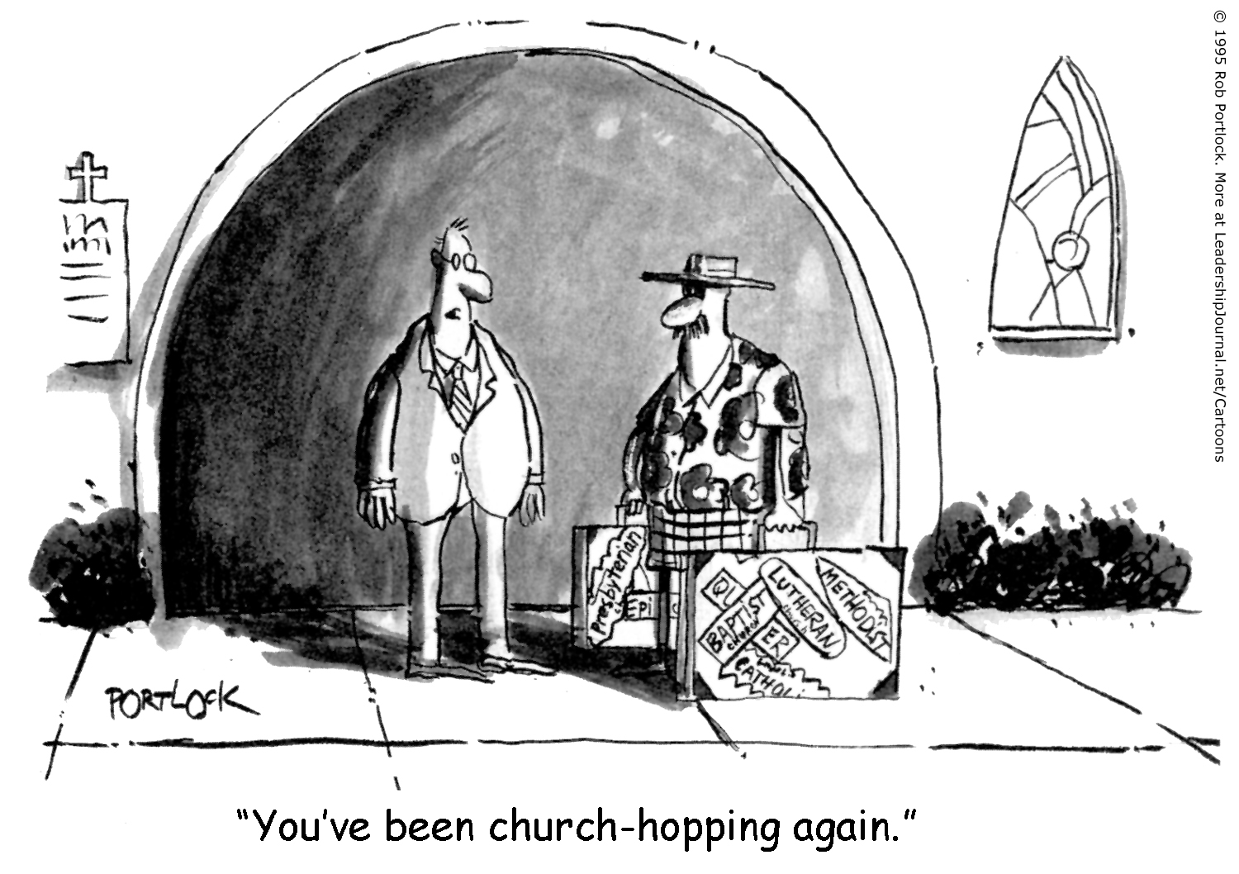

Slide 6
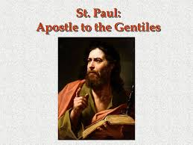
Acts 28:28-31 records this discourse about our Apostle, “Therefore I want you to know that God’s salvation has been sent to the Gentiles, and they will listen! For two whole years Paul stayed there in his own rented house and welcomed all who came to see him. He proclaimed the kingdom of God and taught about the Lord Jesus Christ—with all boldness and without hindrance!”

Slide 7
Therefore, I Will Speak To What Makes A Credible Church In Manifestation. It Will Be Like This.
Dispensational theology is taught and preached without cringe; but with deliberation.
Every kind of human is welcomed, embraced, honored and valued.
A concern for the condition of the soul is a priority.
Debating, teaching, preaching and wrestling with The Word of God is inviting and encouraged.
Holy Spirit is preeminent in Worship and Praise.
All are encouraged to serve in meaningful ways for the common welfare.
All have a voice to edify, rebuke, and persuade others to higher-ordered witness.

