Slide 2
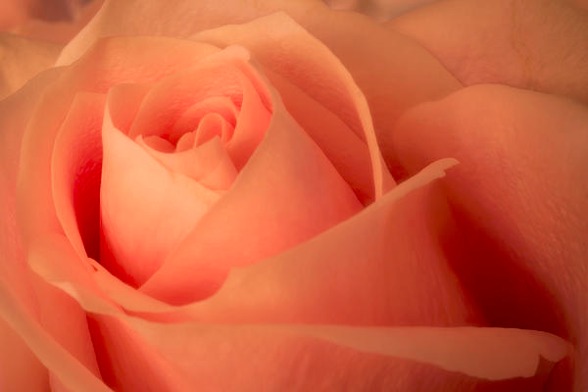
Beauty Within
Notes:
Just take a look at the magazines while checking out at the grocery store to see where our world places value and how it defines beauty. It is mostly outwardly How long does it take to get ready in the morning 30 min. 45 1 hr more
How long do you spend gettting your inside ready?
1 Peter 3:3-4
3 Do not let your adornment be merely outward—arranging the hair, wearing gold, or putting on fine apparel— 4 rather let it be the hidden person of the heart,

Slide 3
Beauty Within
Praise
Notes:
This is what you can do to have inner beauty, praise God
Psalm 147:1
Praise the Lord! For it is good to sing praises to our God; For it is pleasant, and praise is beautiful.
Psalm 33:1
Rejoice in the Lord, O you righteous! For praise from the upright is beautiful.

Slide 4
Beauty Within
Holy Spirit
Notes:
Dwelling place for the HS
Romans 5:5
Now hope does not disappoint, because the love of God has been poured out in our hearts by the Holy Spirit who was given to us.
2 Timothy 1:14
That good thing which was committed to you, keep by the Holy Spirit who dwells in us.

Slide 5
Beauty Within
Gospel
Notes:
Isaiah 52:7
How beautiful upon the mountains Are the feet of him who brings good news, Who proclaims peace, Who brings glad tidings of good things, Who proclaims salvation, Who says to Zion, “Your God reigns!”
Romans 10:15
And how shall they preach unless they are sent? As it is written: “How beautiful are the feet of those who preach the gospel of peace, Who bring glad tidings of good things!”

Slide 6
Beauty Within
Gentle and Quiet Spirit
Notes:
1 Peter 3:3-4New King James Version (NKJV)
³ Do not let your adornment be merely outward—arranging the hair, wearing gold, or putting on fine apparel— ⁴ rather let it be the hidden person of the heart, with the incorruptible beauty of a gentle and quiet spirit, which is very precious in the sight of God.

Slide 7
Beauty Within
Beautiful Creation
Notes:
Psalm 139:14
I will praise You, for I am fearfully and wonderfully made
Ephesians 2:10
10 For we are His workmanship, created in Christ Jesus for good works, which God prepared beforehand that we should walk in them.

Slide 8
Beauty Within
You Are God’s
Notes:
Psalm 139:14
I will praise You, for I am fearfully and wonderfully made; Marvelous are Your works, And that my soul knows very well.
1 Corinthians 6:19
Or do you not know that your body is the temple of the Holy Spirit who is in you, whom you have from God, and you are not your own?

Slide 9
Beauty Within
Take The Time To Get Your Inner Beauty Ready For Each Day
Notes:
AS you Get ready each Morning to meet your Day make sure the inside is at least as ready as your outside. Take the time necessary to show the world the true beauty inside of you Let the world see Christ in you.

