Slide 2
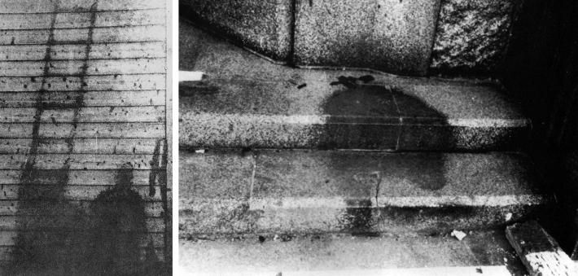
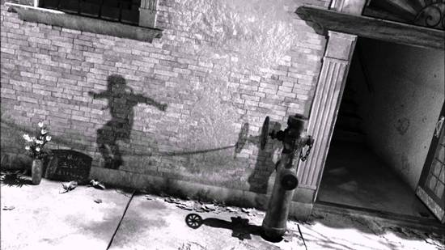

Slide 3
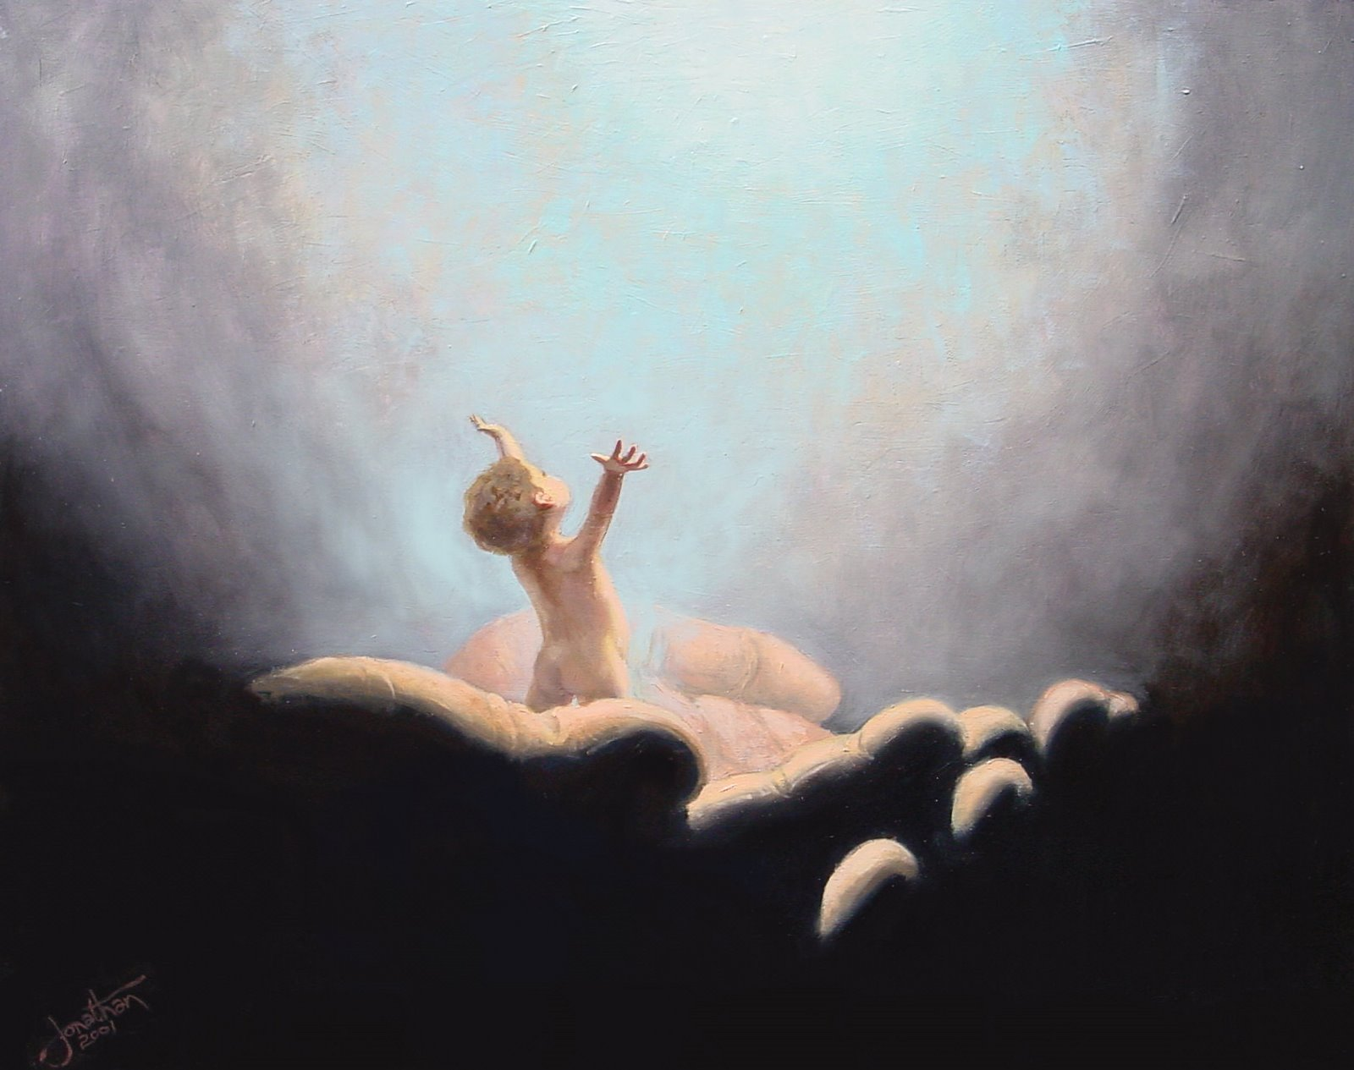

Slide 4
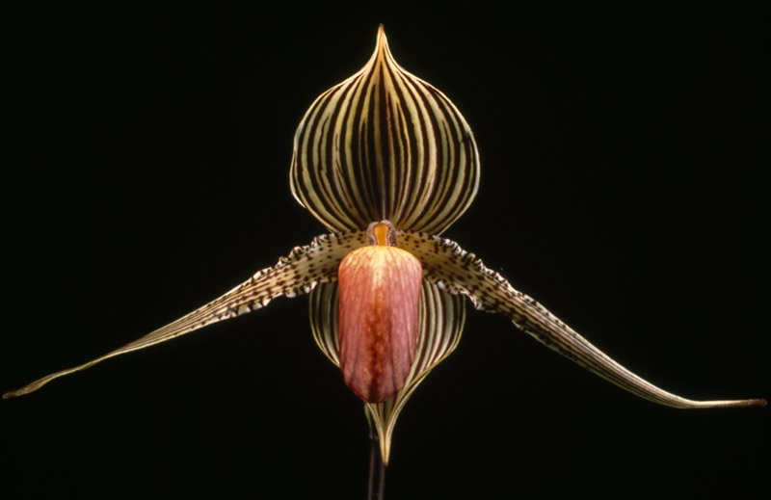
Rotchschild's orchid, which cost about $5,000 per plant

Slide 5
We had better learn to care about not letting souls perish!

Slide 6
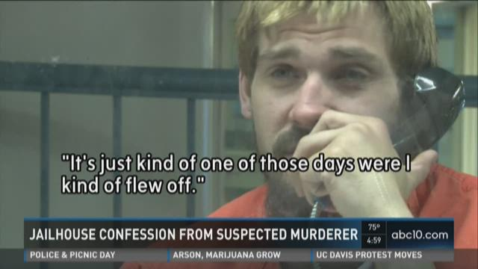

Slide 7
“For the word of God is quick, and powerful, and sharper than any two-edged sword, piercing even to the dividing asunder of soul and spirit, and of the joints and marrow, and is a discerner of the thoughts and intents of the heart.”
Hebrews 4:12

