Slide 2
“For the flesh sets its desire toward the Spirit, and the Spirit toward the flesh; for these struggle with each other, so that you may not do the things that you please.” Galatians 5:17

Slide 3
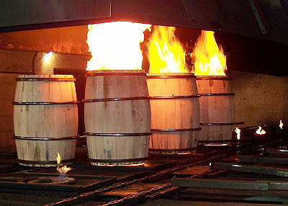
I think that God appreciates the fine building of an aged, spiritual warrior whose composite is a mosaic of walking, talking and being in harmony with Him, without deranged agendas.

Slide 4
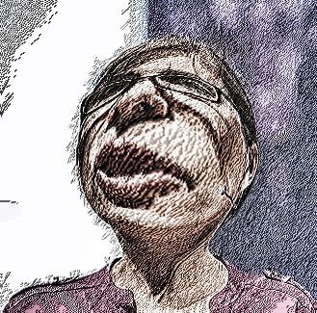
“This is my penitence, tending him.
It is what I deserve.”

Slide 5
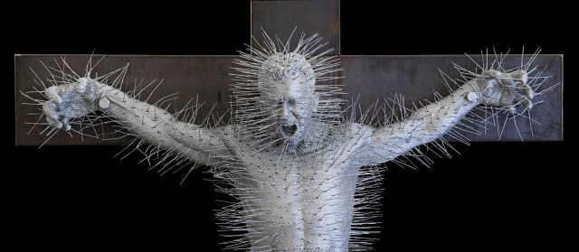
Four things contaminate the soul of the saved:
Unwholesome speech, which includes taking the Lord’s name in vain and vulgarity
‘Hanging with the hanged,’ meaning: celebrating with those who deride our Lord Jesus
Keeping oneself in one’s own misery, meaning: avoiding accountability or community
Arguing with Holy Spirit until exhaustion takes over one’s faith

Slide 6
The four things that uplift the soul are:
Spiritual Songs
Pray/reading the Word of God
Staying close to God’s People and Fellowship
Speaking directly to Holy Spirit

