Slide 2
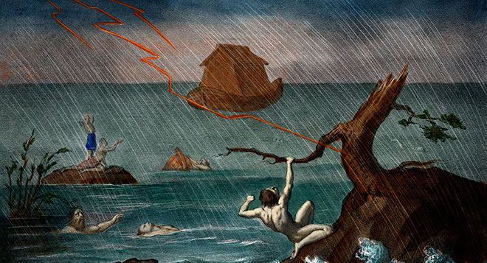
And God intervenes, accordingly;
but in the unbelieving world
in odd ways and by peculiar means

Slide 3
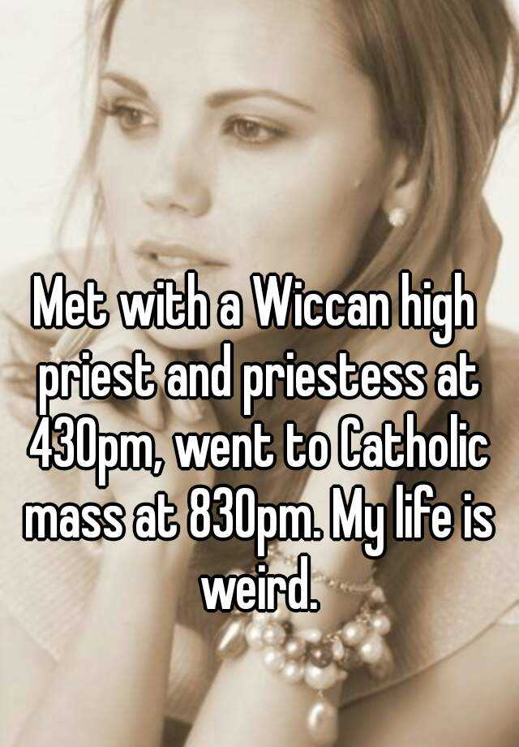
Those who are in the realm
of the flesh cannot please God.

Slide 4
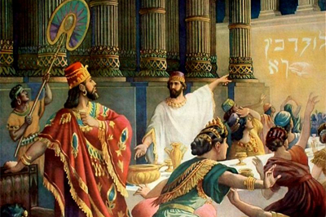
“Then King Nebuchadnezzar fell on his face, prostrate before Daniel, and commanded that they should present an offering and incense to him. The king answered Daniel, and said, “Truly your God is the God of gods, the Lord of kings, and a revealer of secrets, since you could reveal this secret.”

Slide 5
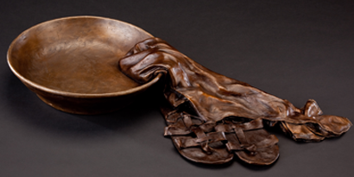
“I have become all things to all men, so that I may by all means save some. I do all things for the sake of the gospel, so that I may become a fellow partaker of it.”

Slide 6
Ways to Let Holy Spirit
‘Ignite Fire in You for Those People!’
Give them the real deal and expect them to be
purchased alive by the Real Way, Truth and Life!
Open the Dialogue—don’t be ashamed of the Gospel
Ask yourself—‘Who knows I love Jesus? Who is aware of the building I gather with my church? Who knows my peculiar doctrine? Whom have I shared the gospel story with or used the Name of Jesus in meaningful conversation?’

