Slide 1
Notes:
Christmas a time for
Reflection
Contemplation
projection

Slide 2
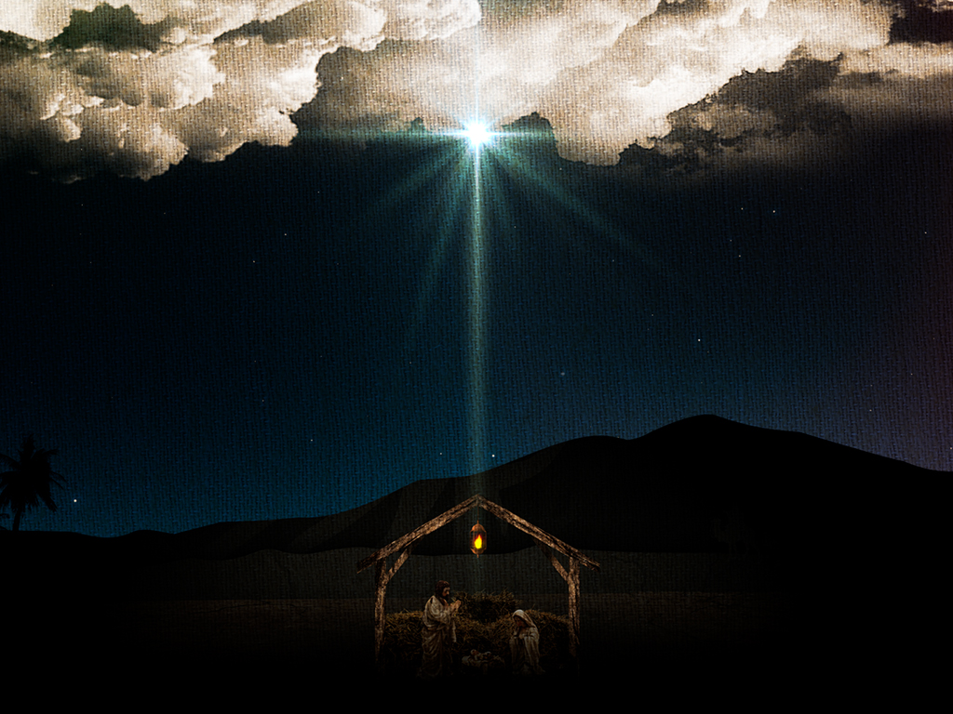
Reflection
Notes:
Because of what He did back then who is He to us today

Slide 3
Reflection
Who Was Christ when He was born
Savior – Jesus
God with us – Immanuel
King of the Jews
Christ - Messiah
Notes:
Savior – Jesus
God with us – Immanuel
Christ – Messiah ; the promised and expected deliverer of the Jewish people. The annointed one of God
Matthew 1:21-23 New King James Version (NKJV)
21 And she will bring forth a Son, and you shall call His name Jesus, for He will save His people from their sins.”
22 So all this was done that it might be fulfilled which was spoken by the Lord through the prophet, saying: 23 “Behold, the virgin shall be with child, and bear a Son, and they shall call His name Immanuel,” which is translated, “God with us.”
Footnotes:
Matthew 2:2-4 New King James Version (NKJV)
2 saying, “Where is He who has been born King of the Jews? For we have seen His star in the East and have come to worship Him.”
3 When Herod the king heard this, he was troubled, and all Jerusalem with him. 4 And when he had gathered all the chief priests and scribes of the people together, he inquired of them where the Christ was to be born.

Slide 4
Contemplation
Notes:
Contemplation means to think about and ponder thoughtful observation.
full or deep consideration

Slide 5
Contemplation
Who Is Christ to us today
Savior
Lord – Master
Head – of the Body
Notes:
Romans 10:12
For there is no distinction between Jew and Greek, for the same Lord over all is rich to all who call upon Him.
Galatians 3:28 New King James Version (NKJV)
28 There is neither Jew nor Greek, there is neither slave nor free, there is neither male nor female; for you are all one in Christ Jesus.
He Is the one who makes us “together” with God
Lord – Master the one who defines what and how we live . The one who we give up control to
Head – The source for
Colossians 2:19
and not holding fast to the Head, from whom all the body, nourished and knit together by joints and ligaments, grows with the increase that is from God.

Slide 6
Projection
Notes:
What do we have and who do we want to be in the future

Slide 7
Projection
Who will Christ be for us
Head
Destination
Source of eternal life
Notes:
Because of what He did back then who is He to us today
Head
Colossians 1:18 [Full Chapter]
And He is the head of the body, the church, who is the beginning, the firstborn from the dead, that in all things He may have the preeminence.
Eph 1:22 And He put all things under His feet, and gave Him to be head over all things to the church, 23 which is His body, the fullness of Him who fills all in all.
Destination
1 Thessalonians 4:17 [Full Chapter]
Then we who are alive and remain shall be caught up together with them in the clouds to meet the Lord in the air. And thus we shall always be with the Lord.

Slide 8
Reflection
Contemplation
Projection
Application
Notes:
So what
He came as a baby, grew, ministered Died became our Savior now our Job is to live for him to be His ministering agents now and into eternity
Rom 5:8,9
8 But God demonstrates His own love toward us, in that while we were still sinners, Christ died for us. 9 Much more then, having now been justified by His blood, we shall be saved from wrath through Him.
Eph 1:4 just as He chose us in Him before the foundation of the world, that we should be holy and without blame before Him in love. 13 In Him you also trusted, after you heard the word of truth, the gospel of your salvation; in whom also, having believed, you were sealed with the Holy Spirit of promise,
Live for Him not because we have to but because that is who we are (our Identity in Him)
Rom 8:12
Therefore, brethren, we are debtors—not to the flesh, to live according to the flesh. 13 For if you live according to the flesh you will die; but if by the Spirit you put to death the deeds of the body, you will live. 14 For as many as are led by the Spirit of God, these are sons of God. 15 For you did not receive the spirit of bondage again to fear, but you received the Spirit of adoption
If what you are doing is not getting you closer to God you need to look at what you are doing, and how you are doing it
Definition of insanity doing the same thing over and over again expecting different results
Pray for the Holy Spirit to direct you to

