Slide 2
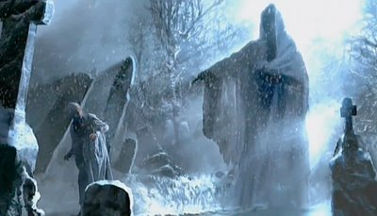

Slide 3
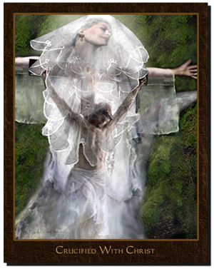
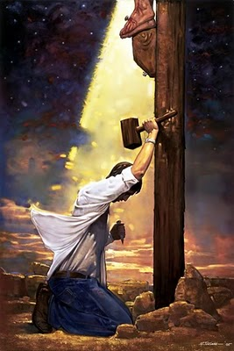
“I am crucified with Christ: nevertheless I live: yet not I, but Christ lives in me, and the life I now live in the flesh, I live by the faith of the Son of God, who loved me, and gave Himself for me.”
“Husbands, love your wives, even as Christ also loved the church, and gave Himself for it.” Ephesians 5:25

Slide 4
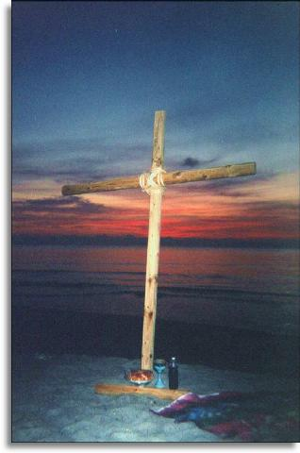
And I, if I be lifted up from the earth, will draw everyone to Me.
This He said, signifying what death He should die.
John 12:32-33
Which God ordained before the world to our glory: which none of the princess of this
world knew: for had they known of it, they would not have crucified the Lord of Glory.
I Corinthians 2:7-8

Slide 5
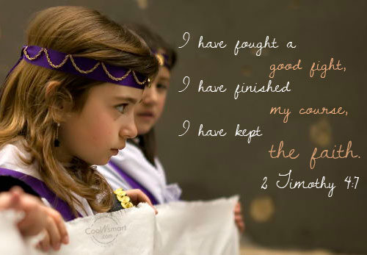

Slide 6
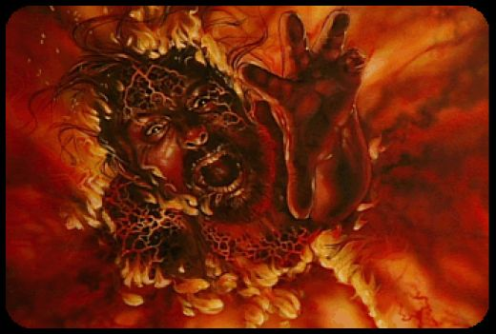
! No child of His shall ever, ever enter into the realm of useless souls, eternal separation or The Lake of Fire !

Slide 7
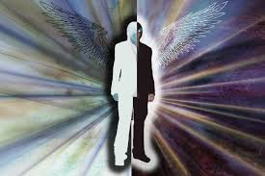
Do You See Dead People?
Bring Them To Life!

