Slide 2
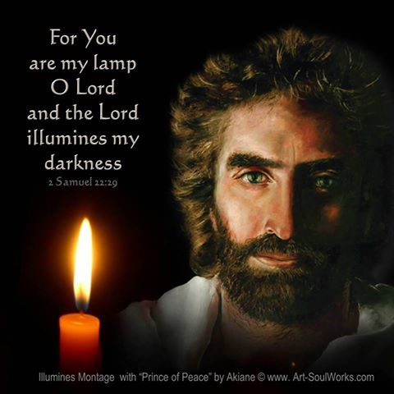

Slide 3
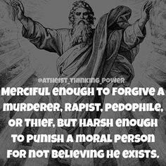

Slide 4
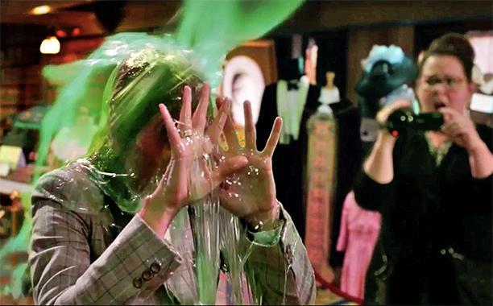

Slide 5
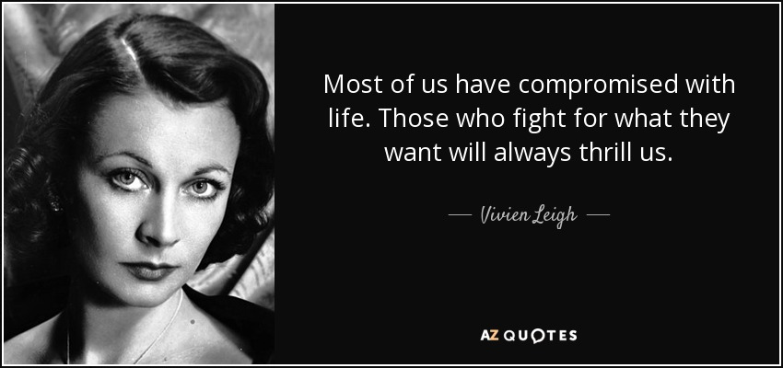

Slide 6
The Three Fundamentals Are:
Jesus Christ is God and He was crucified and rose from the dead to redeem all the souls who accept and confess this as reality. Never waver from this Truth!
The Holy Spirit and the Word of God are the final arbitrators in all matters of faith practice and definitions of right/wrong and good/bad. Never waver from this Truth!
The Community of Faith that most closely aligns with Pauline Doctrine is hallowed ground and the prime place to worship and be taught in accordance with Grace. Never waver from this Truth!

Slide 7
This is what I teach, when any believer is intruded in a manner that cannot be defended against.
It is a 3-fold process.
Put the anger and hurt into neutral like the gear shift of transmission. Do not seek to forgive (unless it is asked for) by grinding forward, nor go to bed angry Ephesians 4:26 by grinding the matter in reverse. Leave it all in idle mode.
Give the issue time to mellow. Many things are being worked by Holy Spirit in synergy with an outcome that predicts positive resolution. Ponder this verse: “If anyone destroys God's temple, God will destroy that person; for God’s temple is sacred, and you together are that temple.” I Corinthians 3:l7
Finally, listen to this: “Do not take revenge, my dear friends, but leave room for God's wrath, for it is written: It is mine to avenge; I will repay, says the Lord.” Romans 12:19

