Slide 2
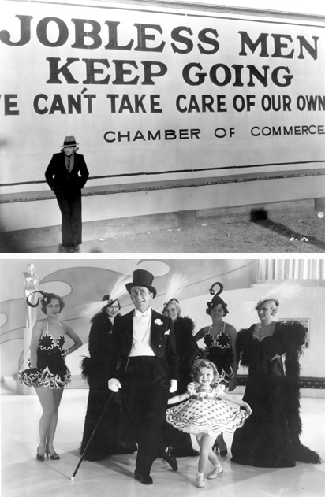
“You will
always have
the poor
among you.”
Matthew
26:11a

Slide 3
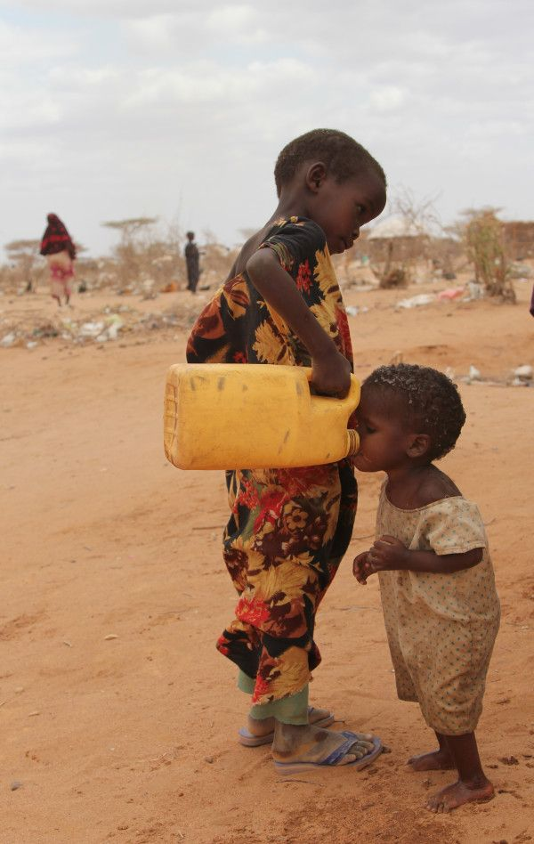

Slide 5
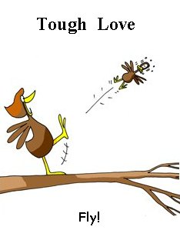

Slide 6
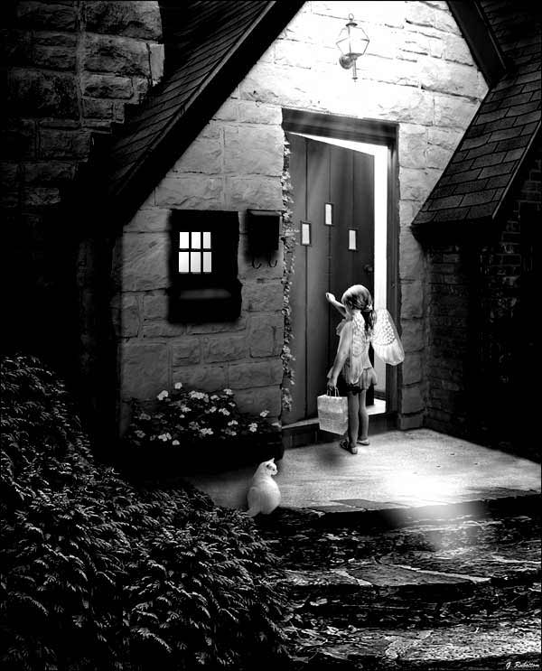
The resources of the church must be used to build the relationships
The resources of the church must be used to build the relationships

Slide 7
The resources of the church must be used to build the relationships
Try to be excellent in the kindness given.
Put oneself in the heart of the expressed need.
Put oneself in the heart of the expressed need.
Seek the meaning regarding the urge to do good.

