Slide 3
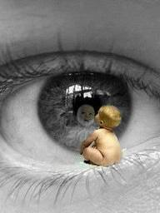
“Keep me as the apple of the eye;
Hide me in the shadow of Your wings.”
Psalm 17:8

Slide 4
“The LORD does not look at the things people look at.
People look at the outward appearance,
but the LORD looks at the heart."
I Samual 16:17b

