Slide 3
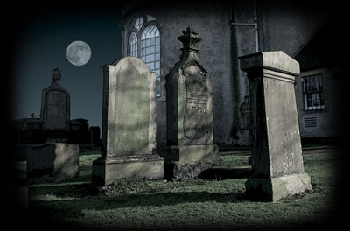
These mausoleums, relics and remnants of
the dead ones (within or without) may be revered,
worshipped, thought to bring about miracles,
enshrined with wealth and though usually kept away
From the general masses; are still accessible,
tangible; but dead and decayed!

Slide 4
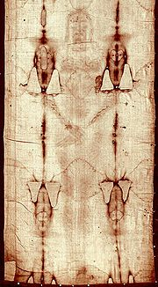
HIS BODY WAS RESURRECTED!
HE ONLY STANDS IN THIS CATEGORY ALL BY HIS GOOD, GOOD SELF!
NO OTHER IDOLIZED RELIGIOUS FIGURE HAS EVER RASIED FROM THE DEATH OR BODY PARTS TRANSFIQURED.

Slide 5
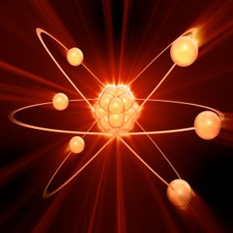
There are four fundamental forces of physics, which govern all created matter. These are:
Gravity which is a purely attractive force reaching through even the “empty” void of space to draw two masses toward each other. It keeps the planets in orbit around the sun and the moon in orbit around the Earth.
Electromagnetism is the interaction of particles with an electrical charge. Charged particles at rest interact through electrostatic forces, while in motion they interact through both electrical and magnetic forces.
Weak Nuclear Force that acts on the scale of the atomic nucleus. It causes phenomena such as beta decay that enforces destruction.
Strong Nuclear Force that keeps nucleons (protons & neutrons) bound together.
This is the law that governs Creation. (Hebrews 1:2c-3a)
“He made the worlds; who being the brightness of glory, and the express image of His person, and upholding all things by the word of His power.”

Slide 6
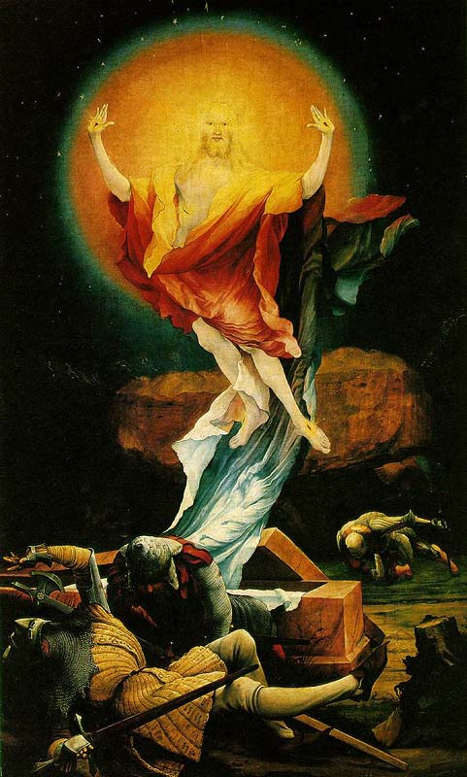

Slide 7
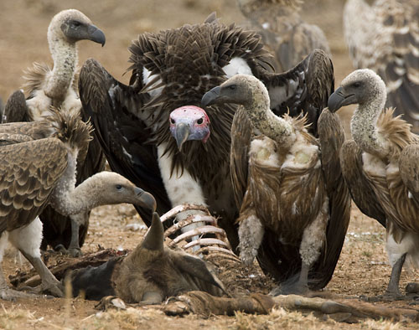
Paul uttered,
“that I may know Him and the power of His resurrection, and the fellowship of His sufferings, being conformed to His death, if by any means, I may attain to the (sic. out) resurrection) from the dead (sic. ones, things).
Philippians 3:10-11
Understand that all believers are called to this intense place; though few dare to exhibit the bravery required to arise and come out of dead places and stop ‘hanging’ with dead things and cease from doing anything with the dead ones!

