Slide 1
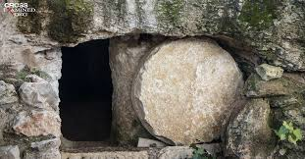
1 Corinthians 15:12-19
“Now if Christ be preached that He rose from the dead, how say some among you that there is no resurrection of the dead? But if there be no resurrection of the dead, then is Christ not risen: And if Christ be not risen, then is our preaching vain, and your faith is also vain. Yes, and we are found false witnesses of God; because we have testified of God that He raised up Christ: whom H raised not up, if so be that the dead rise not. For if the dead rise not, then is not Christ raised: And if Christ be not raised, your faith is vain; you are yet in your sins. Then they also which are fallen asleep in Christ are perished. If in this life only we have hope in Christ, we are of all men most miserable.”

Slide 2
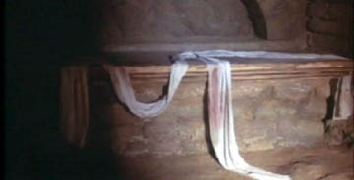
Hours later this tomb was found to be ‘empty’ and the Body was never found!

Slide 3
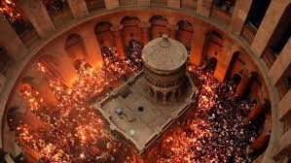
The place where Jesus was lain is now covered by a shrine located within the Church of the Holy Sepulcher in Jerusalem.

Slide 4
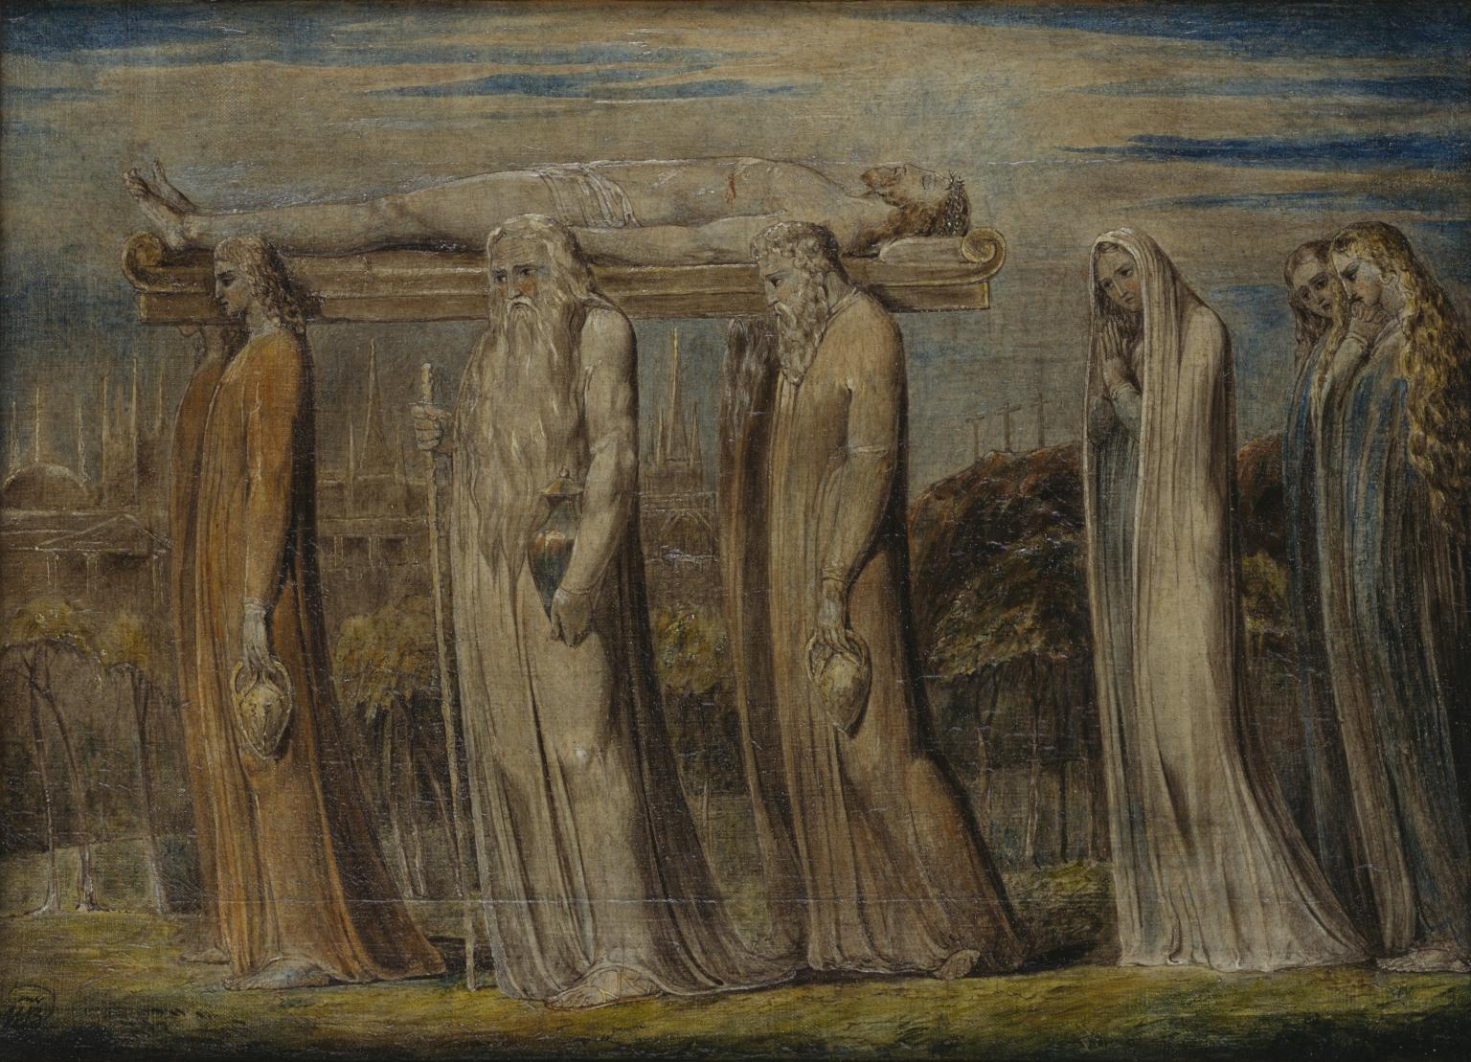
People, we are often like empty tombs, awaiting some kind of miracle to lift Us out of our despair and crave a new, supernatural experience to prove our God cares!
We moan in our circumstances and believe God has abandoned Us.
We can be cynical, resentful, bitter and blame and shame.

Slide 5
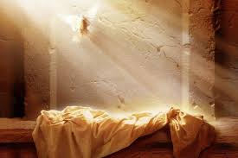
(Philippians 3:10)
“I want to know Christ--yes, to know the power of his resurrection and participation in his sufferings, becoming like him in his death.”

