Slide 2
Santa It Is What Easter Is all About

Slide 3
Just Kiddin’
April Fools !!!!!!

Slide 4
Happy Easter !!

Slide 5
Let Me Tell You A Story which Started Before Time As We Know It
Notes:
Ephesians 1:4
just as He chose us in Him before the foundation of the world

Slide 6
He chose us in Him before the foundation of the world
Ephesians 1:4
Notes:
Ephesians 1:4
just as He chose us in Him before the foundation of the world
We were Plan A way before the covenant with Israel

Slide 7
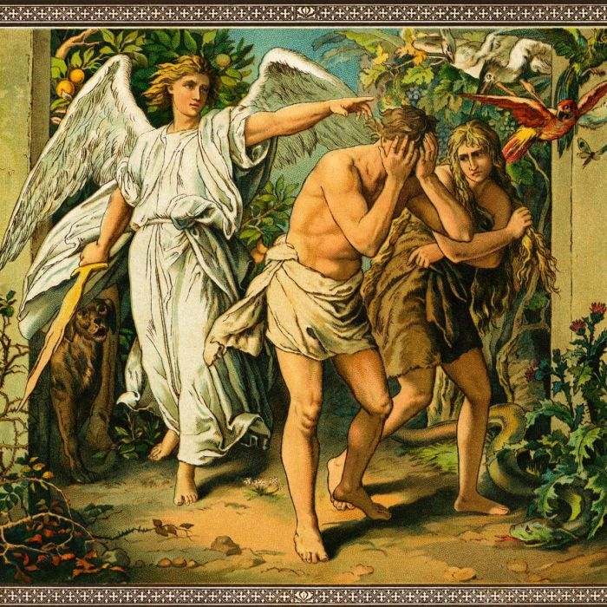
After Creation Man Died (Separate) from God
Notes:
Romans 5:12
Just as through one man sin entered the world, and death through sin, and thus death spread to all men …
So Starts our Jouirney From Death to Life and Life everlasting

Slide 8
God Dealing With Man in many Different ways
Everyone did what was right in there own eyes
Went further from God
God flooded world – new people
Mankind turned from God
God made a covenant with one man (one People) Promised salvation through their seed
That nation rejected God in Form of Christ
Notes:
God Varied from plan A because of reaction of His creation

Slide 9
God Dealing With Man in many Different ways
Brings us to the reason for our celebration today
Notes:
God Varied from plan A because of reaction of His creation

Slide 10
From Death To Life
A Savior That Died So We Can Live
Notes:
God who gave up a part of himself so we could have Him again
The Humbled and Exalted Christ
Phil. 2:5-11
5 Let this mind be in you which was also in Christ Jesus, 6 who, being in the form of God, did not consider it robbery to be equal with God, 7 but made Himself of no reputation, taking the form of a bondservant, and coming in the likeness of men. 8 And being found in appearance as a man, He humbled Himself and became obedient to the point of death, even the death of the cross. 9 Therefore God also has highly exalted Him and given Him the name which is above every name, 10 that at the name of Jesus every knee should bow, of those in heaven, and of those on earth, and of those under the earth, 11 and that every tongue should confess that Jesus Christ is Lord, to the glory of God the Father.
Luke 24: 1-6
Now on the first day of the week, very early in the morning, they, and certain other women with them,[a] came to the tomb bringing the spices which they had prepared. 2 But they found the stone rolled away from the tomb. 3 Then they went in and did not find the body of the Lord Jesus. 4 And it happened, as they were greatly[b] perplexed about this, that behold, two men stood by them in shining garments. 5 Then, as they were afraid and bowed their faces to the earth, they said to them, “Why do you seek the living among the dead? 6 He is not here, but is risen!
God was separated so we (male, female, save, free, Jew, non-jew} would have the opportunity to never be again
Listen to this
Romans 8:11
But if the Spirit of Him who raised Jesus from the dead dwells in you, He who raised Christ from the dead will also give life to your mortal bodies through His Spirit who dwells in you.
Not only is He alive , Because He is alive We, who believe, are alive with his never to be separated again Not only alive but eternally alive. Plan A is alive and well.

