Slide 2
How many of you have family members who are lost? Friends? Co-Workers?

Slide 3
^{Colossians 4:2-6}
² Continue earnestly in prayer, being vigilant in it with thanksgiving; ³ meanwhile praying also for us, that God would open to us a door for the word, to speak the mystery of Christ, for which I am also in chains, ⁴ that I may make it manifest, as I ought to speak.
⁵ Walk in wisdom toward those who are outside, redeeming the time. ⁶ Let your speech always be with grace, seasoned with salt, that you may know how you ought to answer each one.

Slide 4
But Why do they need us to be praying for them?

Slide 5
The Lost will not and indeed cannot be saved unless someone prays for them.

Slide 6
The Lost are prisoners which Satan refuses to release (Isaiah 14:17)

Slide 7
Slaves under Satan’s authority and jurisdiction (Acts 26:18)

Slide 8
Children of the Devil (John 8:44)

Slide 9
“Energized” by Satan (Eph 2:2)

Slide 10
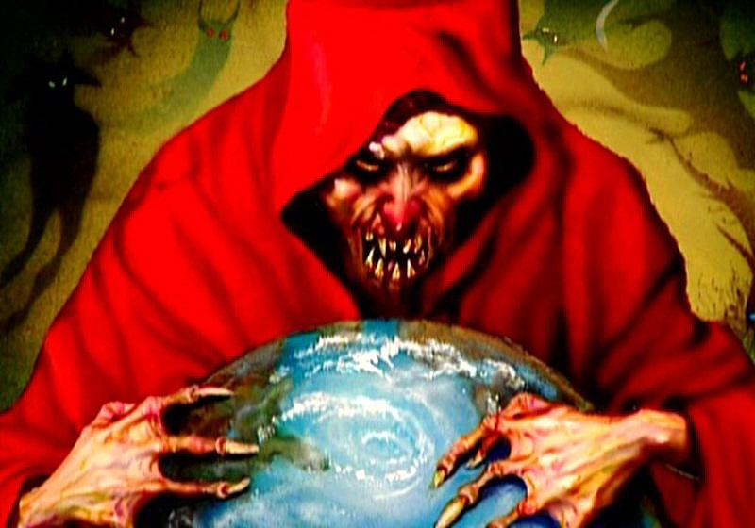
Helplessly held in Satan’s grasp (1 John 5:19)

Slide 11
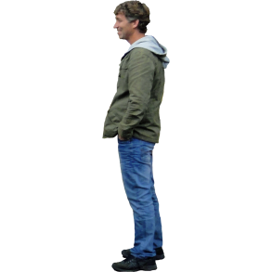
And a strong man’s house (Mark 3:27)

Slide 12
And they are blinded to the Gospel 2 Corinthians 4:3-4

Slide 13
2 Corinthians 4:3-4
“But if our gospel be hid, it is hid, it is hid to them that are lost; In whom the god of this world hath blinded the minds of them which believe not, lest the light of the glorious gospel of Christ, who is the image of God, should shine unto them.”

Slide 15
The Greek word for foolishness is “Moria” from which moron is derived.

Slide 16
To try to share
With someone in this condition is almost impossible without the right weapons primarily prayer.

Slide 17
We need to understand what our family and friends are up against. And then realize that we can play a part in their salvation by praying!

Slide 20
This is a Spiritual Battle/War that we are in. The Primary purpose in praying for the lost is NOT to convince God to save them. For He is “not willing that any should perish” 2 Peter 3:9

Slide 22
A brief review of the Biblical description of their desperate situation will help us understand this critical truth.

Slide 23
Children of the Devil (John 8:44)

Slide 24
And they are blinded to the Gospel 2 Corinthians 4:3-4

Slide 25
“Energized” by Satan (Eph 2:2)

Slide 26
Helplessly held in Satan’s grasp (1 John 5:19)

Slide 27
And a strong man’s house (Mark 3:27)

Slide 28
Eph 2:2 Wherein in time past ye walked according to the course of this world, according to the prince of the power of the air, the spirit that now works in the sons of disobedience.”

Slide 29
The Greek word for works is energeo “to energize”

Slide 31
God has provided powerful weapons for us to use in this spiritual war.

Slide 32
Mark 3:27 Jesus himself said “No man can enter into a strong man’s house, spoil his good, unless he first bind the strong man.(Satan)

Slide 33
Satan’s armor is a mindset

Slide 35
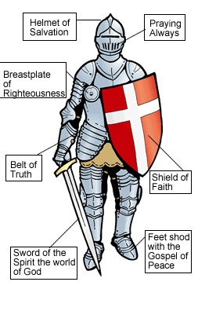
Ephesians 6:12-20 Full Armor of God to stand against powers of this age. Truth, Righteousness, the Gospel, Faith, the Word of God, and Prayer

Slide 36
Our weapons are designed to do 4 things For tearing down stronghold For tearing down any arguments/imagination/speculations And tearing every arrogant obstacle(all ignorance) against God‘s word/Knowledge And to bring into captivity every thought into the obedience of Christ

Slide 37
God has given us, the church, weapons to use (in prayer) to pull down Satan

Slide 38
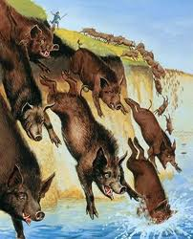
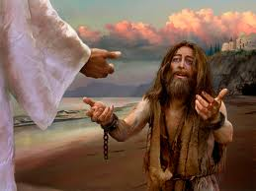
Wild Man in Gerasene. (Mark 5:1-15)

Slide 40
So how does the Satan do this work?
By a stronghold of unbelief.
Remember a stronghold is a mind set against the will of God or basically Sin.
This is only sin that can send you to hell, unbelief

Slide 41
John 3:18
“He who believes in Him is not condemned; but he who does not believe is condemned already, because he has not believed in the name of the only begotten Son of God. And this is the condemnation, that the light has come into the world, and men loved darkness rather than light, because their deeds were evil.”

Slide 42
Unbelief is the only sin that will send someone to hell. Not Adultery, drunkenness, stealing, anger etc..

Slide 44
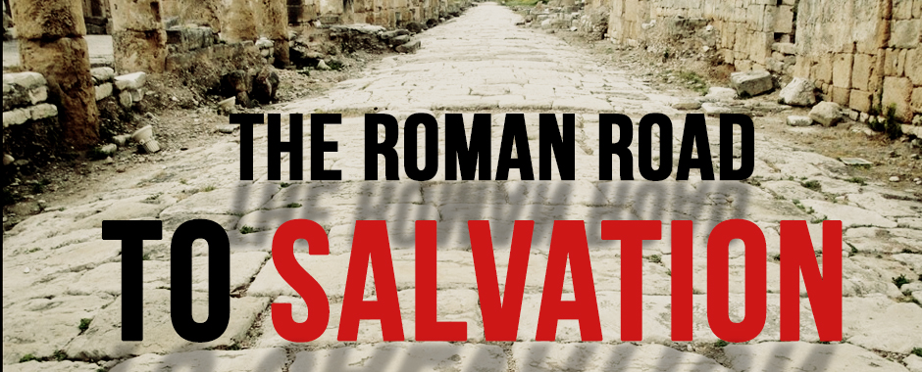

Slide 47
