Slide 1
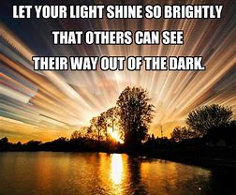
“Evidence of Things Seen”
So what’s the evidence of things they do See?”
Notes:
Pastor Harl spoke last week on the “Evidence of things not seen” That people recorded seeing Jesus doing miracles, that He lives, was crucified and then over 500 people testified of His Resurrection and His body was never found. Today there are millions of people who would testify of God’s existence,, of the presence of the Holy Spirit indwelling us and of our faith in the living God!
These are all things that are unseen but our faith and experiences say they are true. So what about the things that are SEEN in us. This evidence is real, for everyone to see, every day by 100’s of people that we interact with daily. This evidence is through words and our actions.

Slide 2
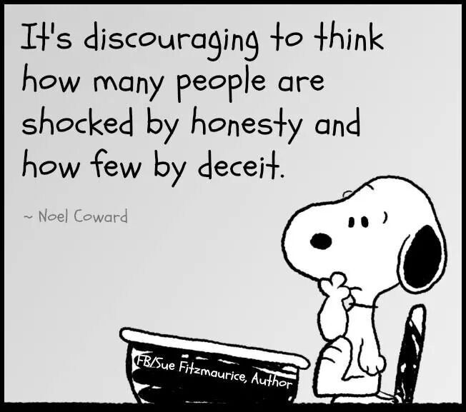
“Actions Speak Louder Than Words”
“Do our “walking the walk” & “talking the talk” match our Christian identity?”
Do our Christian words and
and actions stay the same when we leave here?
Notes:
In today’s world it is hard sometimes to keep our Christian values up to par. Everywhere we go we are faced with choices that get harder and harder. We as Christians are not sinners because of Jesus covering our sins with His payment on the cross. But we can still fall slowly into sinful behaviors that lead farther and farther away from what God wants us to be. And what are our actions and words saying to the world about who we are?
So my question to all of us is: “How are we doing fighting the slippery slope to man’s ways when we leave here?
We are bombarded day and night with negativity. We all see morals and values going downhill. Relationships breaking up left and right. Kids having a harder time just getting through school. TV, internet, radio and social media are letting such ugly and horrific event invade our minds all the time. It seems to me that I have to be watching how I let my attitude be effected. People seem to have simmering anger on the surface just ready to spill over and their actions are so hateful.We need to guard our minds and watch our own actions so we don’t get sucked up into all of this. It can be so easy and almost un-noticeable.

Slide 3
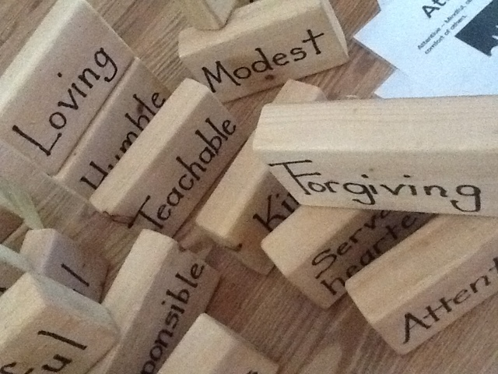
LET LOVE BE OUR life changing GUIDE
Notes:
READ SCRIPTURE We need to let love keep ruling in our hearts.
We need to be forgiving, humble, loving, understanding and teachable. Turn off all the negative input and tune into the Bible where good things can change your attitude and ultimately YOUR LIFE!!!

Slide 4
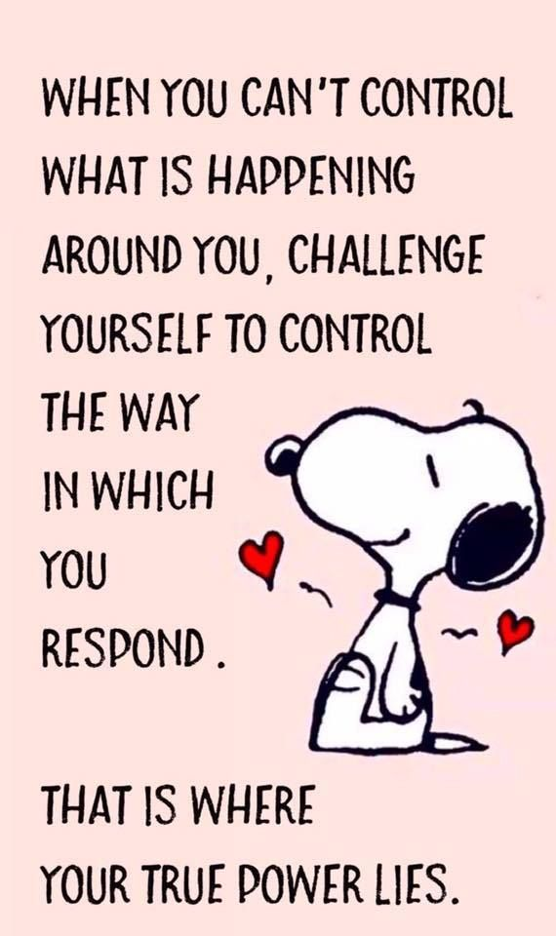
THE HOLY SPIRIT IS OUR POWER
“That He would grant you, according to the riches of His glory, to be strengthened with might (power) through His Spirit in the inner man. Eph. 3:16
“Now to Him who is able to do exceedingly abundantly above all that we ask or think, according to the power that works in us.
Notes:
READ ENTIRE PAGE

Slide 5
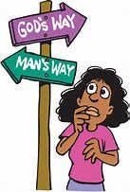
Notes:
So here is a glimpse of a conversation I had doing a simple thing like advertising the Food Bank
After I sent her all the info. AGAIN she said:
KK- Hey will you share this video. It’s for the Vets! Unless you don’t have time but it would be good.
ME- “I really don’t have time to share things from others. I am a pastor at this church, but God bless you for caring!”
KK- “I got it from a friend & out of respect I did this! So I see why I don’t believe in YOUR GOD! You all say spread the word…I do & you complain about it.
ME- (taking a deep breath and fighting getting mad, I write) I do love Jesus and want everyone else to also but I just can’t respond to everyones requests. I love your outreach, please keep it up. Our world needs people like you! Thanks for understanding.
KK- Oh I am so sorry. I took it out on you & God. I am sorry
ME- No problem. You are a very kind hearted person, I can tell. It really would be great for you to learn about Jesus for He really does love you. Have a beautiful summer!
I had to make that choice. What way was I going to follow. I was able to show Jesus’s love even in hateful circumstances. So….

Slide 6
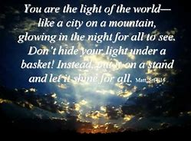
let your inner & outer light shine
Notes:
So think how much brighter your light will shine when your inner self matches you outer actions!!!!!

