Slide 2
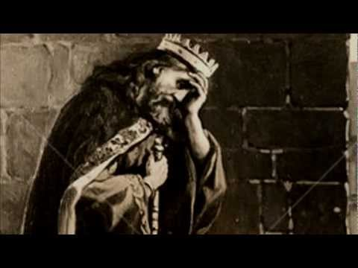
“O my son Absalom, my son, my son Absalom! Would God I had died for you, O Absalom, my son, my son!”
2 Samuel l8:33

Slide 3
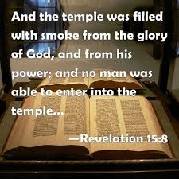

Slide 4
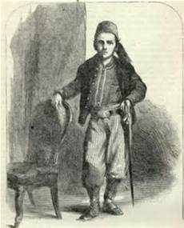
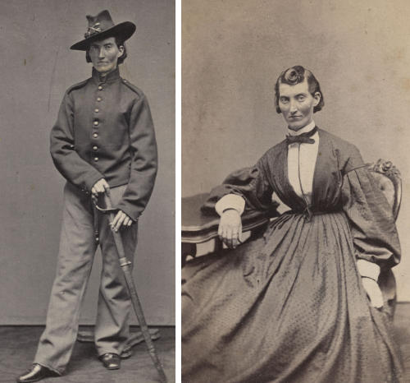
John W. Peckman
Mary Owens (before and after)

Slide 6
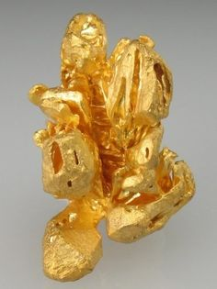
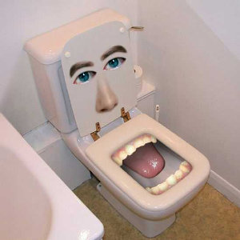
“In a large house there are articles not only of gold and silver, but also of wood and clay; some are for special purposes and some for common use.”
2 Timothy 2:20

Slide 7
