Slide 1
Hebrews 11:1
“Now faith is the substance of things hoped for, the evidence of things not seen.”
Here is the two ways the Word of God defines ‘faith’:
Hebrews 11:1
“Now faith is the substance of things hoped for,
The evidence of things not seen.”

Slide 3
2 Corinthians 5:7
declares “For we (believers in God) walk by faith, not by sight.”

Slide 4
The dictionary meaning
of ‘substance’ is
defined two ways:
A particular kind of matter with uniform properties.
The real physical matter of which a person or thing consists, and which has a tangible, solid presence.

Slide 5
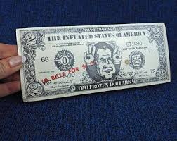
One of the two Greek words for ‘substance’ and used in our passage, is ‘hoopostasis’ which is akin to submission: to place belief in the word and authority of an overseer and support that one’s desires.
The other is ‘hooparzis’ which means ‘hard assets.’ Hebrews 10:34 states to the readers, “For you had compassion of me in my bonds, and took joyfully the spoiling of your goods, knowing in yourselves that you have in heaven a better and an enduring substance.”
BACKED BY THE FULL FAITH AND CREIDIT OF CHRIST! NOT BY THIS GUY

Slide 6
There are two dictionary meanings of ‘hope.’
A feeling of expectation and desire for a certain thing to happen.
A feeling of trust

Slide 7
Romans 3:22 avows
“Even the righteousness of God which is by faith of Jesus Christ unto all and upon all them that believe: for there is no difference”

