Slide 2
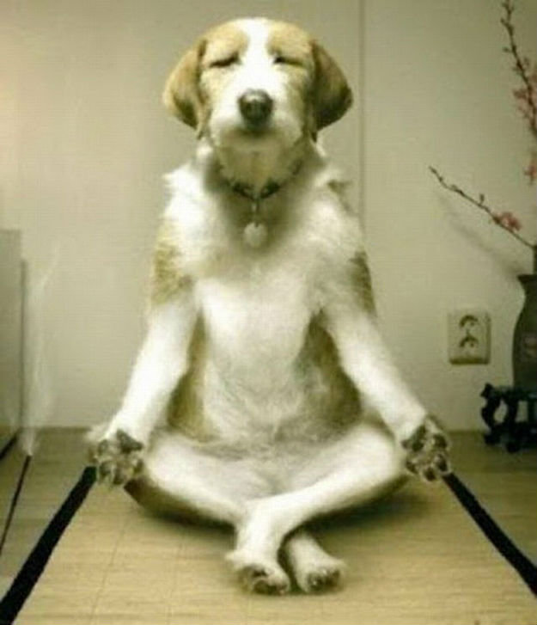

Slide 3
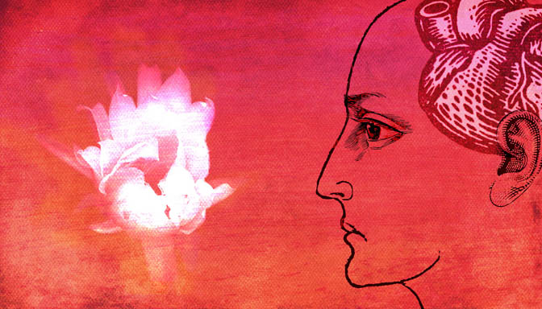
“And you shall love the Lord your God with all of your mind.”
Mark 12:30

Slide 4
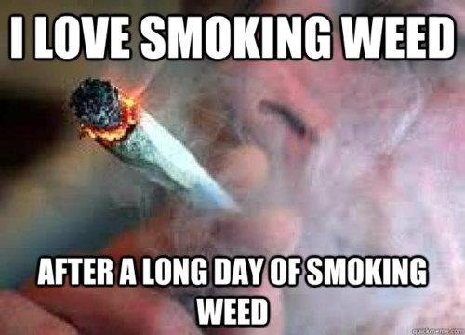

Slide 5
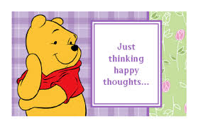
“Finally, brethren, whatsoever things are true, whatsoever things [are] honest, whatsoever things [are] just, whatsoever things [are] pure, whatsoever things [are] lovely, whatsoever things [are] of good report; if [there be] any virtue, and if any praise, meditate on these things.”
Philippians 4:8
AND
“Meditate upon these things; give yourself wholly to them; that your profit may appear to all.”
1 Timothy 4:15

Slide 6
“Set your mind on things above, not on the things of the earth.”
Colossians 3:2
One can almost hear the music in the verse. It sings out:
The redeemed are not momentary but our afflictions or circumstances sure are!
Our Hope is vested in our true friendships and relationships,
Remembrance and understanding that goodness, kindness, innocence and heroes of righteousness abound.

Slide 7
