Slide 1
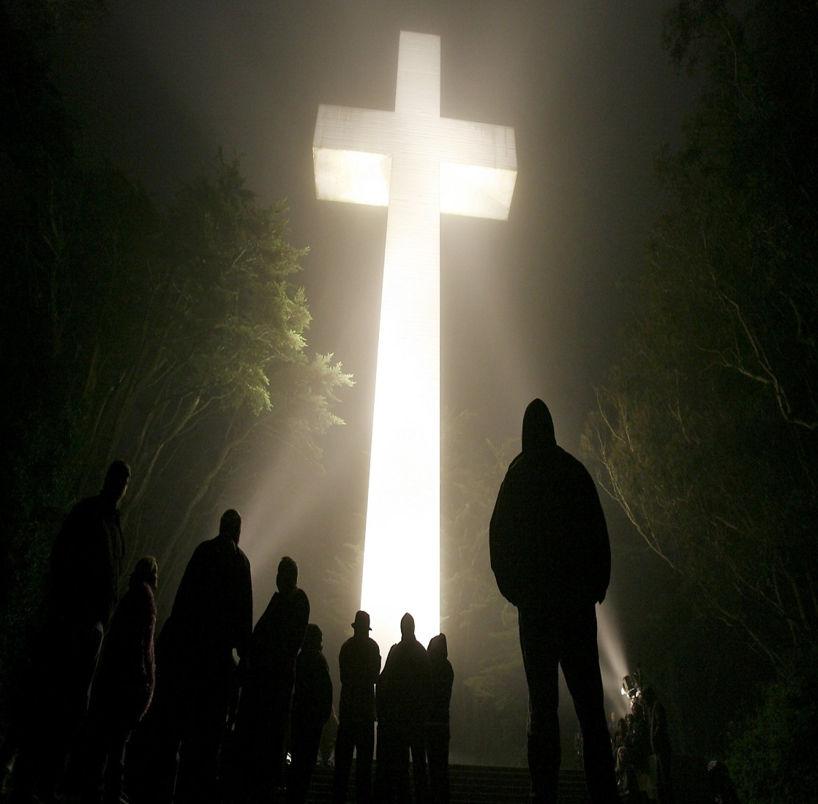
HOW FOGGY IS YOUR FAITH

Slide 2
Notes:
About a month ago I was heading up Kipling about 6:30am on my way to our elder meeting on Friday morning when I came to this creepy wall of fog I had to drive into. All the cars around me
Were slowing down and the drivers seemed to be having the same reaction that I was, “WHAT IS THIS!?!” I had never run into this before. Should I stop, go a different route, was it all over the whole
City, what???? I was leaving sunshine and easy driving and going into the unknown, weird and kind of scary circumstances without much faith in a good outcome. As I inched my way through it the
Fog kind of rolled and moved around my car like it was getting out of my way. All of us navigated the road for about a half mile and then it kind of dissipated and the light started to appear again.
It un-nerved me a little and I told Gary it was kind of like the TWILIGHT ZONE show. Just plain creepy.
Life circumstances can all of a sudden be just like this. Leaving us feeling all alone, not knowing what to do, making decisions with not much guidance and leaving us shaken and hoping we were right.

Slide 3
Notes:
How confident are we in our faith in God that He will see us through every situation that life throws at us? How certain are we that we can get
Through and hold strong? Do we have such a strong relationship with God that nothing will shake us? Life is hard, do we know
That when things get rough He’s got our backs? How do we know??????

Slide 4
PRAYER
Phil. 4:6 Be anxious for nothing, but in everything by prayer and supplication, with thanksgiving, let your requests be made known to God.
Notes:
We’ve got to get to know God more. Just talk!!! What are you thankful for?
What do you need help on? What do you want God to help on for other people. Anything that is on your mind and heart. There is time in every day for prayer.
In your car, at lunch, watering the lawn, in the shower, crazy but Yes! Even in the bathroom. Get in the habit. He wants to hear from you!!!

Slide 5
Notes:
If you want to strengthen your faith, change your life and have a real strong and meaningful relationship with
God take that 1st step to build faith by really talking to Him through prayer!

Slide 6
Notes:
Bring your foggy faith in God into a very personal, daily, real, relationship! Spending time in prayer, reading the Bible
And joining others here who also love God and worship and praise Him. Let Him be a part of your life and faith will grow!!!

