Slide 1
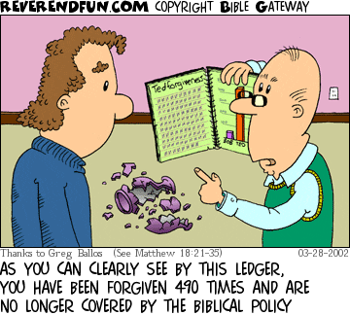
This number (70x7) implies in Hebrew ‘forever.’ There shall be no end to this beneficence.

Slide 4
Here’s the truth.
One is under no obligation to grant
clemency if it is not asked for!

Slide 5
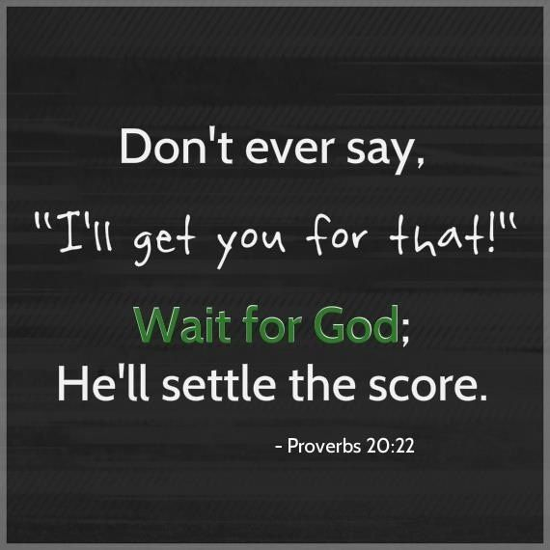
Romans 12:19
“Beloved, do not avenge yourselves, but rather give place to wrath;
for it is written, “Vengeance is Mine, I will repay,” says the Lord.”

Slide 6
Absolution can only be granted by ascertaining:
Has the transgressor ‘owned up and taken full accountability?
Has the transgressor expressed an authentic remorse?
Has the transgressor made commitment to never do the same hurt again?
Has the transgressor offered restitution equal or above the offense?

Slide 7
