Slide 1
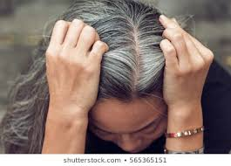
What’s wrong with me! I’m supposed to be able to put my hurt in Jesus’ Hands and let it go!”
“But whoso shall offend one of these little ones which believe in me, it would better for that one that a millstone was hanged about the neck and be drowned in the depth of the sea.”
Matthew 18:6
“If anyone destroys God’s temple, God will destroy him. For God’s temple is holy, and you are that temple.”
I Corinthians 3:7

Slide 2
(Luke 17:4) “ Even if they sin against you seven times in a day and seven times come back to you saying ‘I repent,’ you must forgive them.” But repentance requires (1) an acknowledgement of the wrong done, (2) its’ impact on the victim, (3) acceptance of accountability, (4) offer of restitution and (5) an authentic expression of remorse.
Saying“I’m sorry” just doesn’t do it!

Slide 3
“Forgive someone. Set yourself free!”

Slide 4
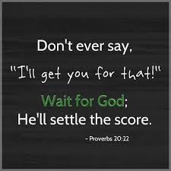
“It is a fearful thing to fall into the hands of the living God.”
Hebrews 10:11
“Dearly beloved, avenge not yourselves, but [rather] give place unto wrath: for it is written, Vengeance [is] mine; I will repay, saith the Lord.”
Romans 12:19

Slide 5
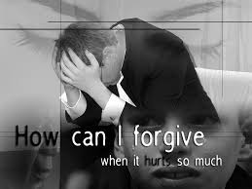
There is a place for the believer to pray for divine retribution rather than the sentiment to ‘just let it go. ´
And no one is obligated to forgive if it isn’t genuinely requested!

