Slide 3
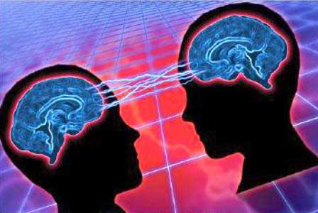
For who can know the LORD's thoughts? Who knows enough to teach Him? But we understand these things, for we have the mind of Christ. I Corinthians 2:16

Slide 4
Acting rightly upon the True Knowledge of Right and Wrong. St. Paul said this to Bishop Timothy, “For God has not given us the spirit of fear; but of power, and of love, and of a sound mind.”
I Timothy 1:7
Comparison of secular thoughts to scripture. Again, from our Apostle: “Which things we also speak, not in words taught by human wisdom, but in those taught by the Spirit, combining spiritual thoughts with spiritual words.
I Corinthians 2:13
Staying in Reality rather than in Fantasy. The ancient adage says, “Keep your heart with all diligence; for out of it are the issues of life.”
Proverbs 4:23
Refusing entrance to seducing messages. (I Timothy 4:1) is about as real as it gets. “Now the Spirit speaks expressly, that in the latter times some shall depart from the faith, giving heed to seducing spirits, and doctrines of devils.”
Turning away from easy passion. Young (2 Timothy 3:22a) was also warned to, “To flee youthful lusts.”
Blocking the clamor of ego-needs. Listen to the harsh sounds of these verses delivered to Bishop (Titus 1:10-11-redacted) “For there are many rebellious people, full of meaningless talk and deception. They must be silenced, because they are disrupting whole households by teaching things they ought not to teach.”

Slide 5
Let Us ‘keep in mind’ what is good to ‘keep in the mind.’

Slide 7
“When I was a child, I spoke like a child, I thought like a child, I reasoned like a child. When I became a man, I gave up childish ways.” I Corinthians l3:11

