Slide 2
Patience

Slide 3
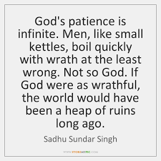
Patience
Notes:
Sometimes we get down and lose our joy because our marriage didn’t turn out as planned , maybe we didn’t get the job we wanted, maybe our kids don’ t do what we expected. The house or lack of, the car we drive even our Health So many times we have all aspects of our lives planned out. We have a spirit of discontentment. This robs us of our Joy
Example Paul in Philippi captured, Beaten, thrown in prison instead of discontentment he sang not the current pop songs but praise and worship songs.
Philippians (NASB)
12 I know how to get along with humble means, and I also know how to live in prosperity; in any and every circumstance I have learned the secret of being filled and going hungry, both of having abundance and suffering need.

Slide 4
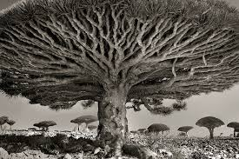
Patience
This is one of the oldest trees in the world.
Look closely—its’ eyes will draw you in!

Slide 5
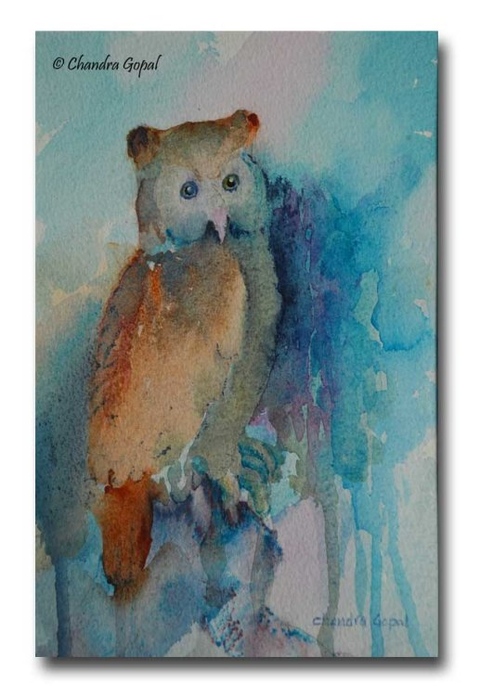
Patience
Allow me to give you some ways to develop spiritual patience.
Resist the temptation to presume an outcome (especially toward the negative).
Remember that Heaven has intentional good will toward God’s lovely children!
Refrain from personalizing.
Stay intimate with Holy Spirit.

Slide 6
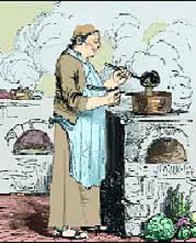
Patience
The Practice of the Presence of God.

Slide 7
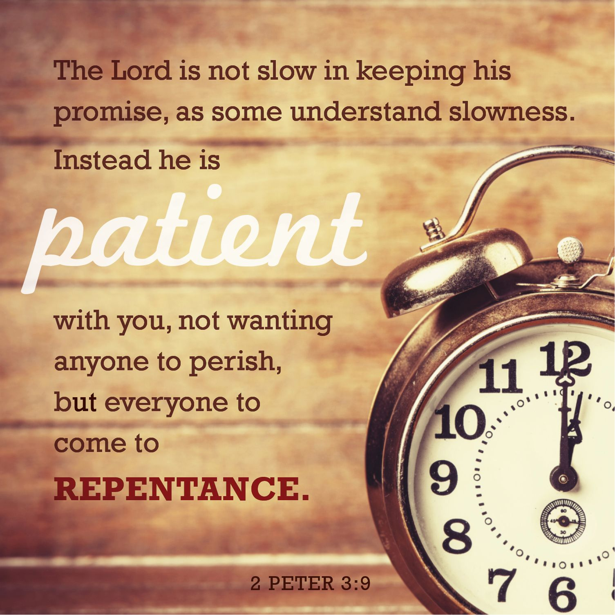
Patience
Notes:
God finds joy in us
Zeph 3:17 “The Lord your God in your midst, The Mighty One, will save; He will rejoice over you with gladness, He will quiet you with His love, He will rejoice over you with singing.”
God Finds Joy in us He breaks out in song
Psalm 104:31 (NKJV)
31 May the glory of the Lord endure forever; May the Lord rejoice in His works.
Isaiah 65:18-19 (NKJV)
18 But be glad and rejoice forever in what I create;
For behold, I create Jerusalem as a rejoicing,
And her people a joy.
19 I will rejoice in Jerusalem,
And joy in My people;
18 But be glad and rejoice forever in what I create;
For behold, I create The Body as a rejoicing,
And her people a joy.
19 I will rejoice The Body,
And joy in My people;
God takes great pleasure in His people If you have trusted Christ as your savior that means YOU!!!
If you find your joy lacking look at what gives God Joy
What song is he singing about you
Remember “ The Joy of the Lord is your strength” Neh 8:10

Slide 8
PATIENCE
Pray
To Find
Patience
Notes:
The Spirit in seeking Joy

