Slide 2
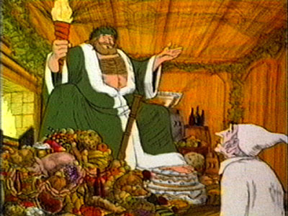
“Come in and know me better, man."

Slide 3
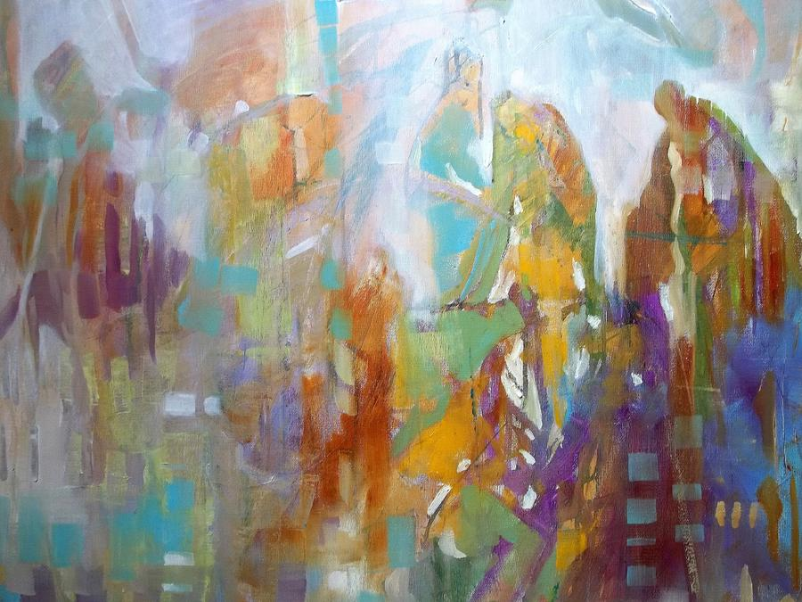

Slide 4
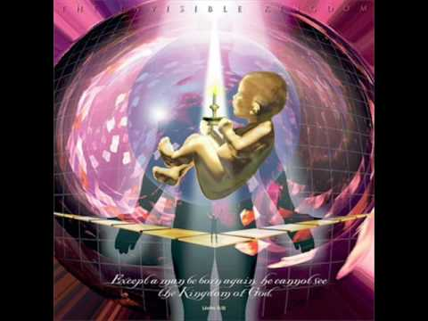

Slide 5
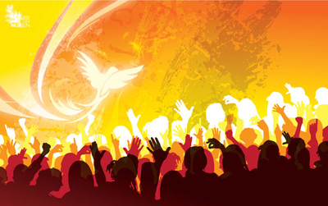
I Corinthians 12:13a says
“For by One Spirit we were all baptized into one body.”

Slide 6
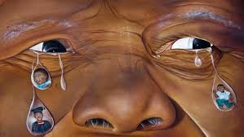
He was a quiet, humble and a man of faith. White, South African racist doctrine and its evil crumbled because Nelson Mandela dared to say it was wrong. He did not use guns or terrorism to accomplish this act—instead it was dignity and moral outrage, with a power from ‘on high.’ He prevailed because he was both mortal and supernatural (at the same time).
All believers are thus endowed.

Slide 7
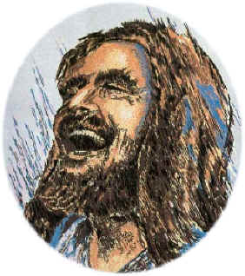
I Timothy 3:l6 declares, “And by great conviction, is the mystery of godliness: God was manifest in the flesh, justified in the Spirit, seen of angels, preached to the heathen, believed on in the world, and received up into glory.”
Come in and get to know Me better, man!

