Slide 2
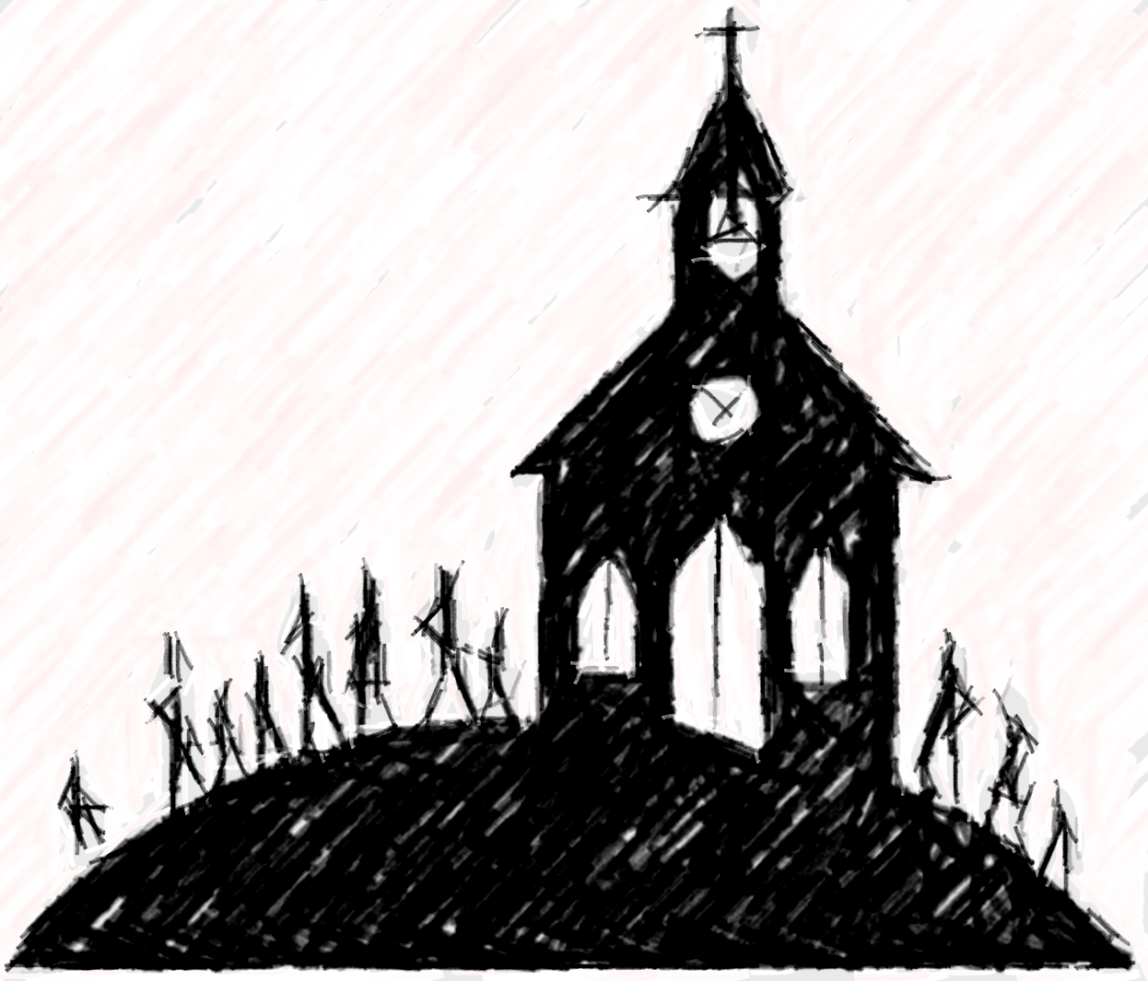

Slide 3
A community has two meanings.
A group of people living in the same place or having a characteristic in common
A feeling of fellowship with others, because of sharing common attitudes, interests, and goals.

Slide 5
Offer Peace and Reconciliation to this dark world and
Take Ownership!
Engage in the public discourse!
Keep in the mind, the proper role of the church. Paul, instructing the church at (Ephesians 4:15-16) says, “but speaking the truth in love, we are to grow up in all aspects into Him who is the head, even Christ, from whom the whole body, being fitted and held together by what every joint supplies, according to the proper working of each individual part, causes the growth of the body for the building up of itself in love.”
Extend Holy Spirit.
Consider this verse. (1 Corinthians 12:13) “For by one Spirit we were all baptized into one body,
whether Jews or Greeks, whether slaves or free, and we were all made to drink of one Spirit.

Slide 6
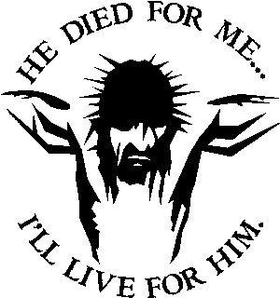

Slide 7
