Slide 2
“Do not be yoked together with unbelievers.
For what do
righteousness and wickedness
have in common?
Or what fellowship can
light have with darkness?”
2 Corinthians 6:14

Slide 5
The Fabulous Four that
rejoices relationships:
Loyalty
Humor
Acceptance
Affection

Slide 6
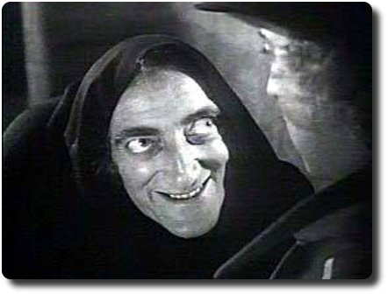
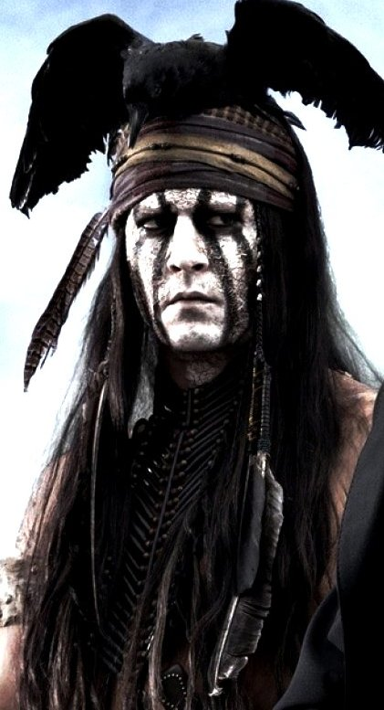

Slide 9
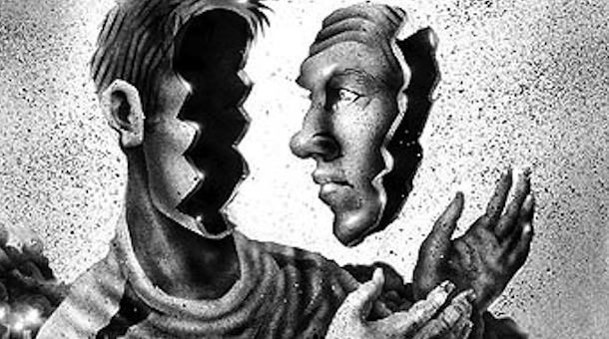
The plain fact is
‘no person can be loved without some kind of onerous expectation.’
But we can accept each other!

Slide 10
“Behold how they love one another”
This what the world should be saying about the
Body of Christ around the world

