Slide 1
Grace Today
Notes:
Paul frequently opened his letters with his desire that his readers experience these twin blessings—grace and peace. Today I want to talk to you about grace, and next week we will discuss peace.
Illus. – At a comparative religions conference at Oxford University, the wise and the scholarly were in a spirited debate about what is unique about Christianity.
Someone suggested that what set Christianity apart from other religions was the incarnation, but it was pointed out that this if found in some other religions too.
Another suggestion was the resurrection; but it was again pointed out that some other religions have accounts of people returning from the dead.
Then, as the story is told, C.S. Lewis, the famous 20th century Oxford Christian apologist, walked into the room a little early for his presentation. After hearing a little of the debate, he asked, “What’s all this rumpus about?”
“We’re debating what’s unique about Christianity.”
“Oh, that’s easy,” answered Lewis. “It’s grace.” Lewis continued by pointing out that only Christianity claims God’s love comes free of charge, no strings attached.
No other religion makes that claim:
• Buddhists follow an eight-fold path to enlightenment. – It’s not free at all.
• Hindus believe in karma, that your actions determine your next life.
• Jews believe that one must keep God’s Law to be acceptable to God
• In Islam, one must do certain actions to appease Allah, who is not a god of love.
• Only Christianity posits a God who loves mankind unconditionally, so much so that He devised a plan to provide salvation as a totally free gift that merely has to be accepted by faith: plus nothing and minus nothing.
Grace is THE distinctive of Christianity, so we need to understand it.

Slide 2
Saving Grace
Ephesians 2:8-9 – For by grace are ye saved through faith; and that not of yourselves: it is the gift of God: 9 Not of works, lest any man should boast.”

Slide 3
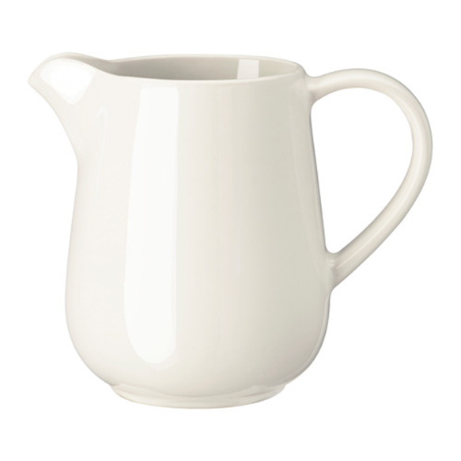
Saving Grace
Notes:
Illus. – In the early 20th century, a minister named Harry Morehouse was walking in a poorer section of the city where he lived, and watched as a boy of five or six came out of a store carrying a pitcher of milk. The little lad made his way carefully along the street, and then slipped and fell. (change slide) The pitcher broke, and the milk ran all over the sidewalk. The boy let out a wail, and Morehouse rushed to see if he was hurt. There was no physical damage, but the youngster wouldn’t be consoled and kept crying repeatedly, “Mama’ll whip me! My mama’ll whip me!”
Morehouse said to him, “Maybe the pitcher isn’t broken in too many pieces; let’s see if we can put it together again.” The boy stopped crying at once and after buying some glue, he watched Morehouse start gluing the pitcher back together. There were one or two failures and each time the boy started crying again, but was silenced by the big preacher. Finally the whole pitcher was complete except for the handle.
Then Morehouse handed the finished pitcher to the little fellow. But within a few steps, the boy knocked the whole thing apart once more. This time there was no stopping his tears, so Morehouse gathered the boy in his arms, walked down the street to a nearby store and bought a new pitcher.(change slide)
Then he and the boy returned to the grocery store and had the pitcher washed and filled with milk. He carried the boy on one arm and balanced the pitcher of milk in the other hand until they arrived at the boy’s home. Very gently he deposited the little boy on his front steps, put the pitcher carefully into his hands and asked, “Now will your mama whip you?” A smile broke across his dirty little face. “Oh, no sir! ’cause it’s a lot better pitcher’n we had before.”

Slide 4
Saving Grace

Slide 5
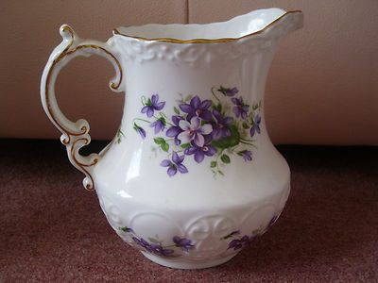
Saving Grace
Notes:
Christ takes our broken lives ,makes them new ( we are a new creation), picks us up, fills us up and carries us until we get home.

Slide 6
Saving Grace
G od’s
R iches
A t
C hrist’s
E xpense
Notes:
So biblically speaking, saving grace may be defined as “the action whereby God freely gives to unworthy, willing recipients that which he does not deserve.”
Grace is nicely expressed in a well-known acrostic of the word:
G od’s
R iches
A t
C hrist’s
E xpense

Slide 7
Sustaining Grace
.
Notes:
The next kind of Grace we have today is Sustaining Grace

Slide 8
Sustaining Grace
2 Corinthians 12:7-9
7 And lest I should be exalted above measure by the abundance of the revelations, a thorn in the flesh was given to me, a messenger of Satan to buffet me (keep me humble), lest I be exalted above measure. 8 Concerning this thing I pleaded with the Lord three times that it might depart from me. 9 And He said to me, “My grace is sufficient for you, for My strength is made perfect in weakness.” Therefore most gladly I will rather boast in my infirmities, that the power of Christ may rest upon me.
Notes:
2 Corinthians 12:7-9New King James Version (NKJV)
The Thorn in the Flesh
7 And lest I should be exalted above measure by the abundance of the revelations, a thorn in the flesh was given to me, a messenger of Satan to buffet me, lest I be exalted above measure. 8 Concerning this thing I pleaded with the Lord three times that it might depart from me. 9 And He said to me, “My grace is sufficient for you, for My strength is made perfect in weakness.” Therefore most gladly I will rather boast in my infirmities, that the power of Christ may rest upon me.

Slide 9
Sustaining Grace
The power and strength to persevere and overcome trials and difficulties.
Notes:
We don’t know for sure what it was, but it was something bad enough that Paul pleaded three times with God for God to lift it from Him. But instead, God chose not to heal him. God’s only answer to Paul was this: “My grace is sufficient for thee, Most gladly therefore will I rather glory in my infirmities…” This is God’s “sustaining grace.”

Slide 10
Sustaining Grace
Struggles
Trials
Obstacles
Oppositions
Despair
Notes:
( Christians in General) How many times have I been in the very valley of despair, facing some trial, or obstacle to my comfort, or opposition, or struggle, and I didn’t think I could bear it any longer! My cross seemed too heavy to bear. I BEGGED the Lord to TAKE it away—to DELIVER me from it. I would say to the Lord, like the Psalmist, “Fearfulness and trembling are come upon me, and horror hath overwhelmed me. 6 And I said, Oh that I had wings like a dove! for then would I fly away, and be at rest. 7 Lo, then would I wander far off, and remain in the wilderness.… 8 I would hasten my escape from the windy storm and tempest.” (Psalm 55:5-8)
But instead of deliverance, the Lord reminded me: “My grace is sufficient for thee.”

Slide 11
Sustaining Grace
“My grace is sufficient for thee.”
Notes:
But instead of deliverance, the Lord reminded me: “My grace is sufficient for thee.”
Which in it’s way is a greater deliverance when we realize our God, ( the One within us), can sustain us no matter what life throws our way

Slide 12
Sustaining Grace
Somehow!!
Notes:
• Somehow, God strengthens His people with grace in the midst of trials.
• Somehow, we overcome.
• Somehow, we’re compelled to go on, to not give up, to trust the Lord, despite the struggles.
Where do we get the power to do that—from the reservoir of God’s sustaining grace. And everyone who has gone through these times of despair and trouble can testify at the end of it that God’s grace is the only thing that got them through it.

Slide 13
Grace Today
Saving
Sustaining
Notes:
We have what the world needs TODAY!!!! Saving Grace and Sustaining grace

