Slide 2
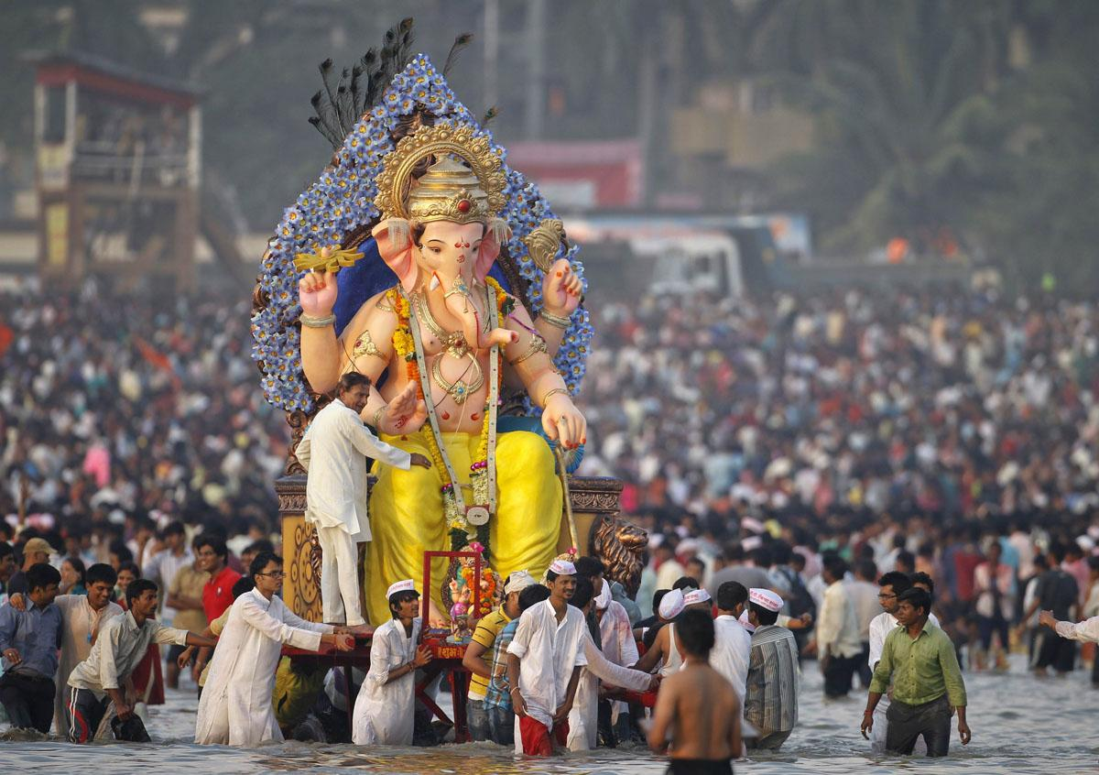

Slide 3
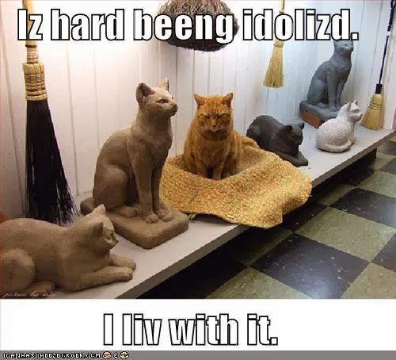
“For although they knew God, they neither glorified Him as God nor gave thanks to Him, but their thinking became futile and their foolish hearts were darkened. Although they claimed to be wise, they became fools and exchanged the glory of the immortal God for images made to look like a mortal human being and birds and animals and reptiles.”
One will never find God in idols.

Slide 4
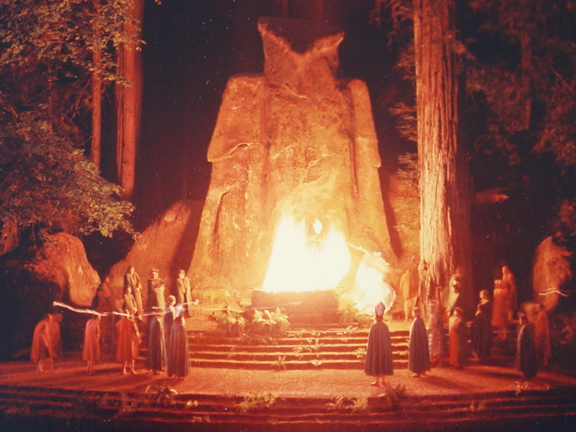
Because the idols of Terah he died in the fire of the Chaldeans, for the Chaldeans worshipped the fire. Terah used to make the idols of their gods, and Haran, his eldest son, used to sell them. But Abram did not worship them. The Chaldeans came to dip both Haran and Abram in the fire, for they were accustomed to dip them in the fire, just as some nations dip their sons in the water. Abram, who did not worship, and who did not bow down to the idol, was saved from the fire of the Chaldeans and was not burnt; but Haran, who feared the idols, who honored them and sold them for worship, was burnt in the fire of the Chaldeans and died.

Slide 6
Remember that at that time you were separate from Christ, excluded from citizenship in Israel and foreigners to the covenants of the promise, without hope and without God in the world.

Slide 7
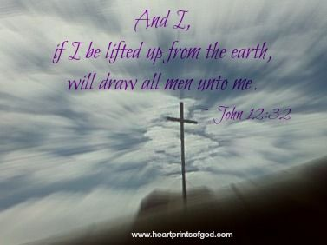

Slide 8
