Slide 2
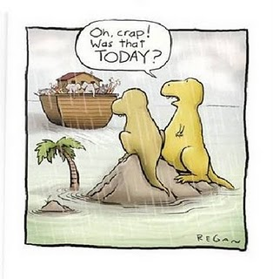

Slide 4
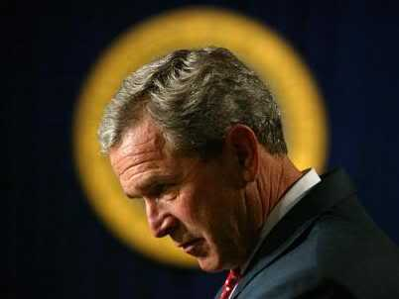
ARE THESE PEOPLE SAFE?

Slide 5
DO YOU AGREE?

Slide 7
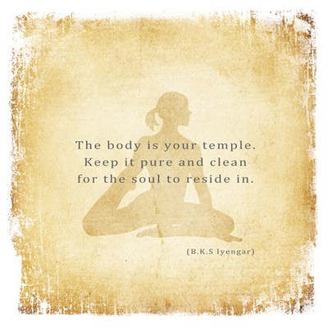

Slide 8
Romans 8:28 “And we know that to them that love God, all things work together unto good, to such as, according to his purpose, are called to be saints.”
Law of Conversion

Slide 9
