Slide 2
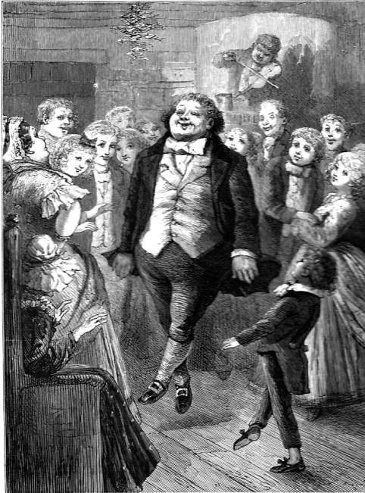
Now this was a prosperous man who knew how to celebrate between the lines of work and play.

Slide 3
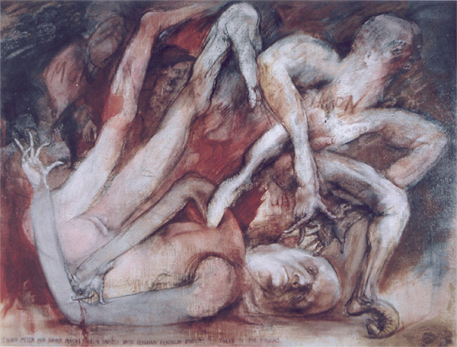
“Your money shall perish with you, because you have thought that the gift of God may be purchased with money. You have neither part nor lot in this matter; for your heart is not right in the sight of God.” (Acts 9:21)

Slide 4
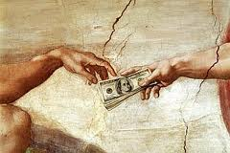
“No servant can serve two masters; for either the servant will hate the one, and love the other, or else the servant will hold to the one, and despise the other. Therefore, no one can serve God and money equally.”
Luke 16:13

Slide 5
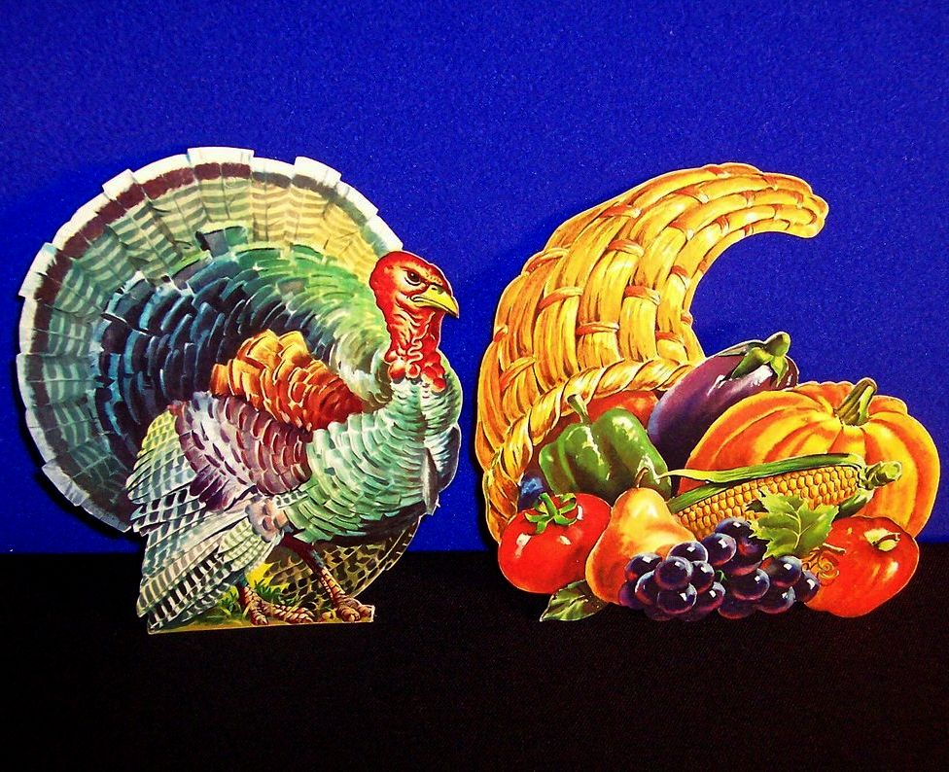
Gobble. Gobble. Gobble UP!

Slide 6
There are three elements that God will prosper in the human endeavor. I will name them.
Sacrifice:
“Seek first the kingdom of God, and His righteousness; and all these (sic. material) things shall be added to you.” (Matthew 6:33)
Generosity:
This is Paul’s testimony. “I have coveted no man’s silver or gold, or apparel. Yes, you know this, that by these hands, I have ministered to my own necessities, and to those that were with me. I have showed you all these things, and by so laboring, one ought to support the weak and to remember the words of the Lord Jesus, how He said “It is more blessed to give than to receive.” (Acts 20:33-35)
Relationship(s):
“Be you kind one to another, tender-hearted, forgiving one another, even as God has forgiven you.” (Ephesians 4:32)

Slide 7
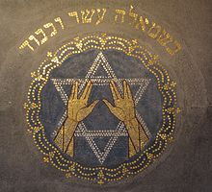
“Shin (W)”
This letter stands for Shaddai, meaning "Almighty (God)".

Slide 8
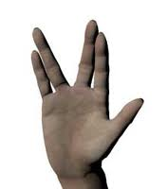
“Live Long and Prosper!”
’tsay-lay-akh’!
’yoo-od-o-o’!

