Slide 2
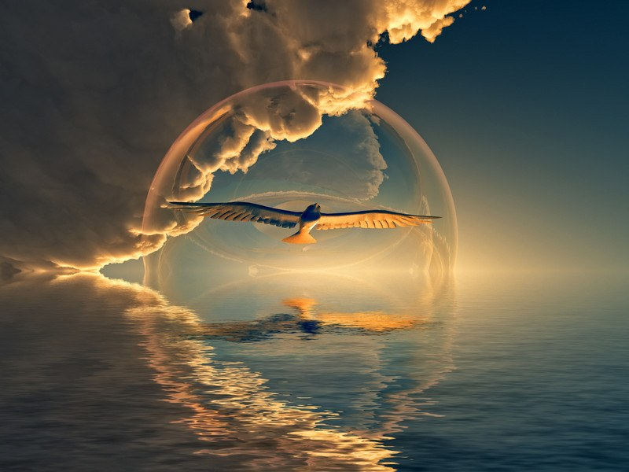
“In the beginning, God created the heavens and the earth. The earth was without form and void, and darkness was over the face of the deep. And the Spirit of God was hovering over the face of the waters.”
Genesis 1:1-2

Slide 3
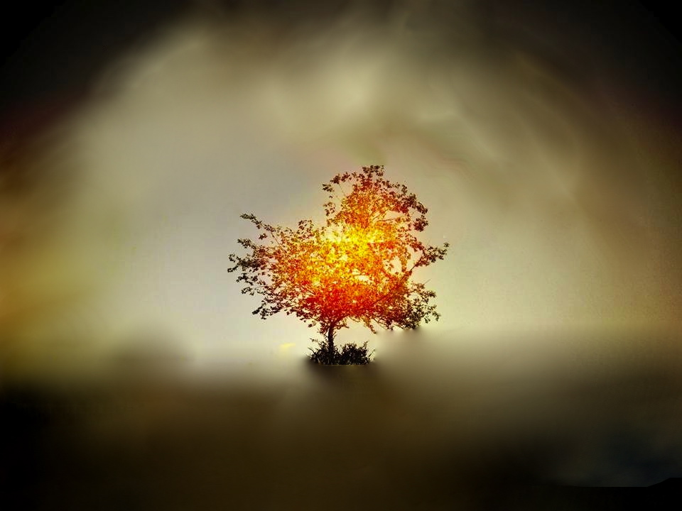
The passion of Spirit, who is symbolized as a dove
Matthew 3:16, a fire Isaiah 4:4, Luke 3:16 and water John 7:39.
Allegorically representing: Peace, Purity and Precipitation or Blood, Sweat and Tears!

Slide 4
Spirit is someone all of US as believers need
to get to know more intimately.
Invite Spirit into one’s whole being
Be relational with Spirit
Ask for Spirit loving
Stay in Sync with what Spirit enjoys

Slide 5
“Do not get drunk on wine, which leads to debauchery. Instead, be filled with the Spirit, speaking to one another with psalms, hymns, and songs from the Spirit. Sing and make music from your heart to the Lord, always giving thanks to God the Father for everything, in the name of our Lord Jesus Christ. submitting to one another in the fear of God.”
Ephesians 5:18-21

Slide 6
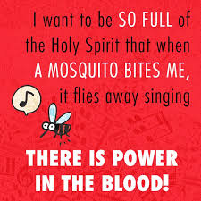
Be in harmony with the community.
Give thanks in all circumstances.
Sing and make music in the soul.
Read and absorb the Word of God and know the Psalms to sing.

