Slide 1
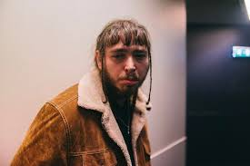
How then shall I live?

Slide 2
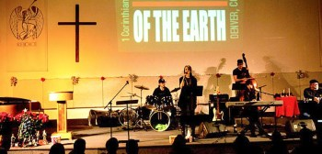

Slide 3
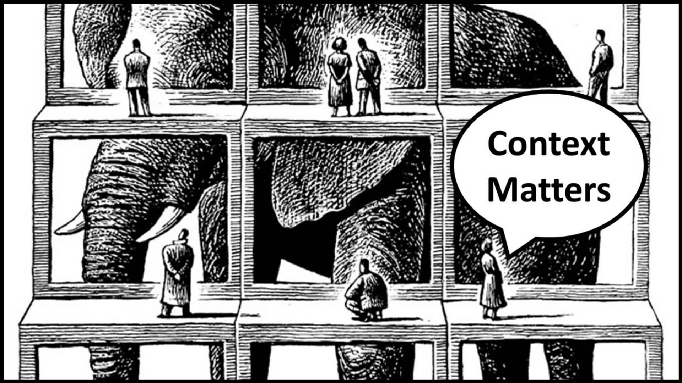
Believers should first live by Context (which means)
‘the circumstances that form the setting for an event, statement, or idea, and in terms of which it can be fully understood and assessed’ and ‘the parts of something written or spoken that immediately precede and follow a word or passage and clarify its meaning’ (who, what, when, where, why)

Slide 4
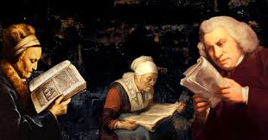
Second. Believers should live by Content (which has four meanings)
1. Something contained such as the topics or matter treated in a written worktable of contents or the principal substance (such as written matter, illustrations, or music)
2. SUBSTANCE, GIST, MEANING and SIGNIFICANCE as in the events, physical detail, and information in a body of work such as art
3. The matter dealt with in a field of study or a part, element, or complex of parts
4. The amount of specified material contained in PROPORTION

Slide 6
