Slide 1
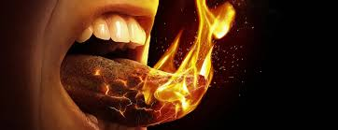
Now the disciples of Jesus were all together in one place. Suddenly a sound like the blowing of a violent wind came from heaven and filled the whole house where they were sitting. They saw what seemed to be tongues of fire that separated and came to rest on each of them. All of them were filled with the Holy Spirit and began to speak in other tongues as the Spirit enabled them.

Slide 2
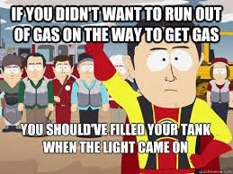

Slide 3
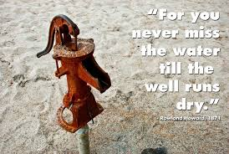

Slide 4
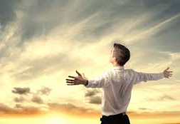
Do not get drunk on wine, which leads to excess. Instead, be filled with the Spirit, speaking to one another with psalms, hymns, and songs from the Spirit.
Sing and make music from your heart to the Lord, always giving thanks to God the Father for everything, in the name of our Lord Jesus Christ, submitting to one another out of reverence for Christ.

Slide 5
THIS IS OUR SAVING GRACE IN THIS DISPENSATION.
IT WORKS LIKE THIS.
FIRST HEED THE ADMONITION
The way to avoid this is to:
Be active in faith community.
By always giving thanks to God the Father for everything.
To Sing and make music from your heart to the Lord.
Dare to speak to one another with psalms, hymns, and songs from the Spirit.

Slide 6
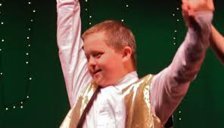
Bobbie is still singing, clapping and making noises at church.
If one does these things, then one will be ‘filled with Holy Spirit!’

