Slide 2
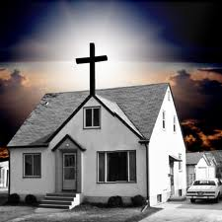
“And they, continuing daily with one accord in the temple, and breaking bread from house to house, did eat their meat with gladness and singleness of heart.” Acts 2:46

Slide 3
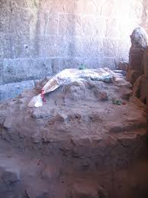
“Not forsaking the assembling of ourselves together, as the manner of some; but rather exhort; and so much more, as you see the day approaching.”
Hebrews 10:25 That ‘approaching day’ was the impending sword, the rack, the beast, the coliseum, the fire, rape and murder of one’s’ wife, children or self.

Slide 4
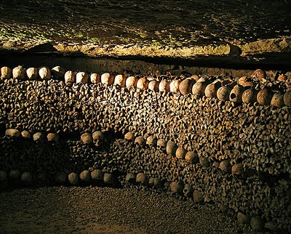
"The catacombs express the solidarity that united brothers and sisters in the faith: the offerings of each one permitted the burial of all the deceased, even the poorest who could not afford the expense of purchasing and preparing a tomb. This collective charity was one of the strong points of the early Christian communities and shielded them from the temptation to return to the ancient forms of religion.” (John Paul II)

Slide 5
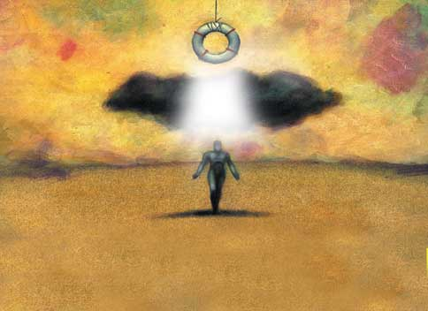
“I beseech you, brethren, to know about the house of Stephanas, that it is the first fruits of Asia, and they have ‘addicted’ themselves to the ministry of the saints.”
I Corinthians l6:l5

Slide 6
“For our best parts have no need: but God has tempered the body together, having given more abundant honor to those parts which seemingly lack meaning; in order that there should be no competition in the body; but the members should have the same care one for another.”
I Corinthians 12:24-25

Slide 7
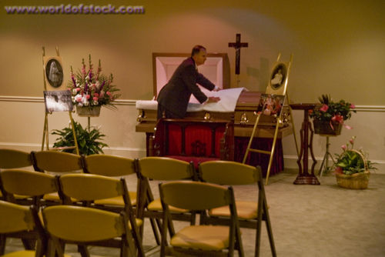
Sometimes, these kinds of offerings seem so meager.

Slide 8
“In whom all the building fitly framed together grows unto an holy Temple in the Lord: in Whom you also are being built together for an habitation of God through the Spirit.”
Ephesians 2:21-22

