Slide 4
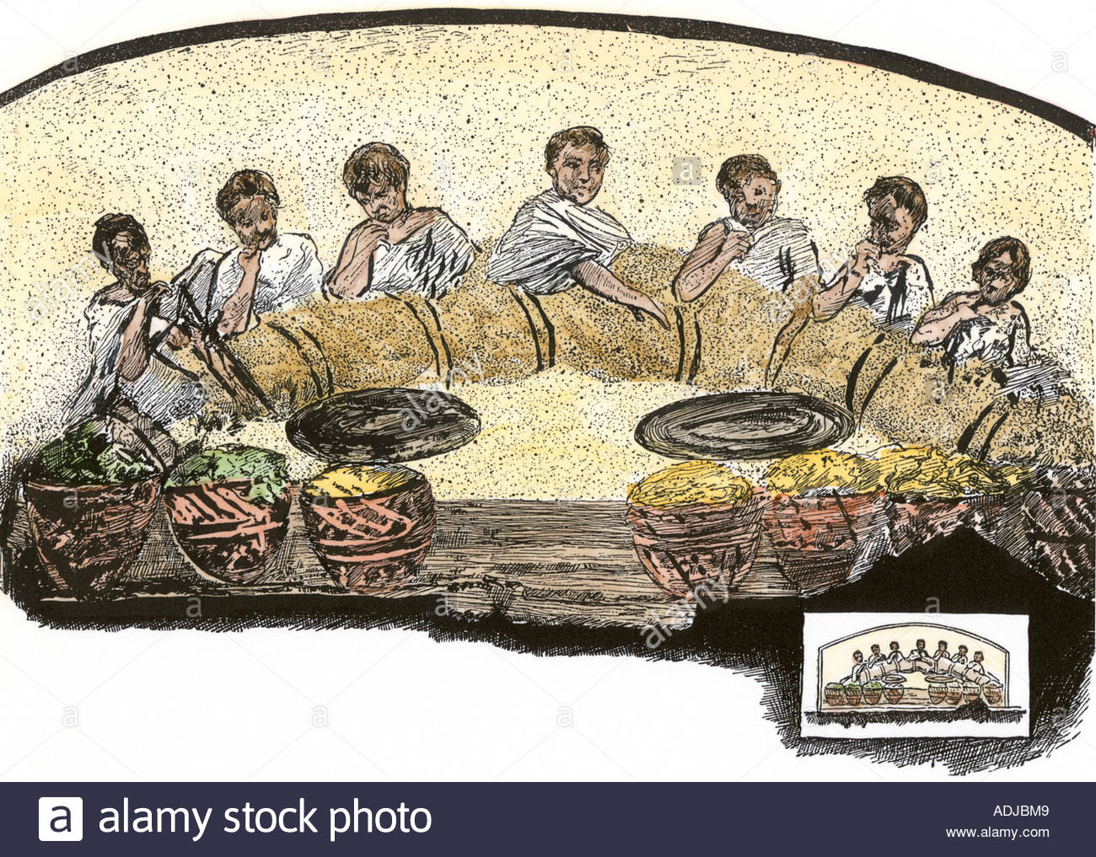

Slide 6
Our home passage in (Galatians 5:22) states that one of the fruits of the Spirit is ‘agape’. Now how does The Body of Christ receive or apply this love?
First: Do not despise it by considering oneself unworthy of it.
Second: Ask Holy Spirit to give one ‘Agape.’
Third: Set aside one’s selfishness to ‘agape’ instead.

Slide 8
But there are some things that community can do to demonstrate love and affection. For instance:
Come prepared to ‘give’ every time community meets.
Ask ‘How can I serve?’ and be willing to do so.
Worship without constraint—lift the hands, clap and contribute your emotions.
Say ‘Amen’ when The Word of God hits home.
Find a way to ‘connect’ with all those who are in this Body and make it a priority to make these relationships meaningful.
Hug or embrace as you feel comfortable.
Refrain from Gossip and keep confidential the weaknesses of others and uphold the ones who struggle with indulgences and yet; keep on trying.

