Slide 2
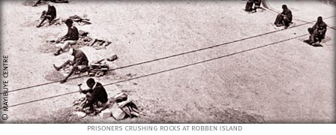

Slide 3
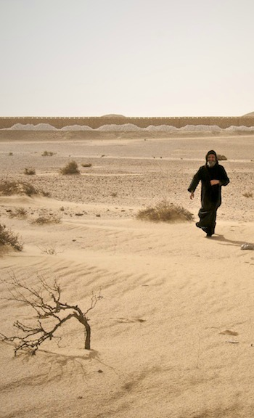
Immediately the Spirit impelled Him to go out into the wilderness. And He was in the wilderness forty days being tempted by Satan; and He was with the wild beasts, and the angels were ministering to Him.
(Mark 1:12-13)

Slide 5
Then Judas, which had betrayed him, when he saw that he was condemned, repented himself, and brought again the thirty pieces of silver to the chief priests and elders, saying, ‘I have sinned in that I have betrayed the innocent blood.’ And they said, ‘What is that to us? See you to that.’ And he cast down the pieces of silver in the temple, and departed, and went and hanged himself.
(Matthew 27:3-5)

Slide 6
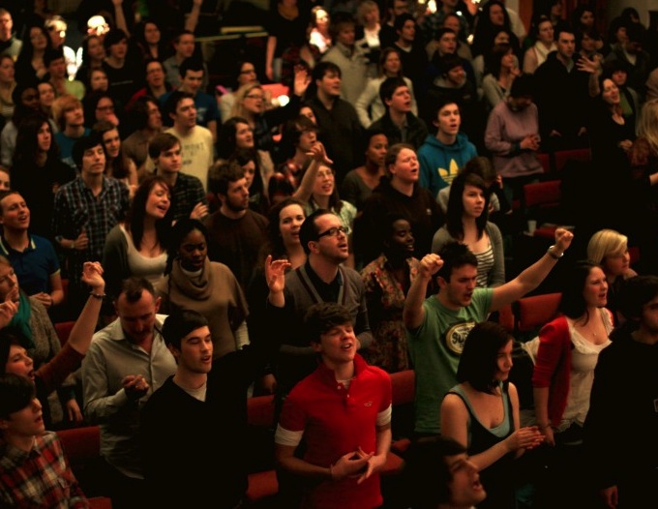
Done by others, Done by self, Done in by rebellion or stupidity.
But it doesn’t have to be any of these!
The vibrant church of the living God has the escape, the validation and the redemption of all of these maladies! Within the congregation are friends, fellowship and good-hearted care!

Slide 7
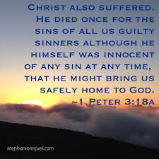
Do not remain in solitary confinement! Don’t remain is despair. Do not stay friendly with the final silence!

