Slide 2
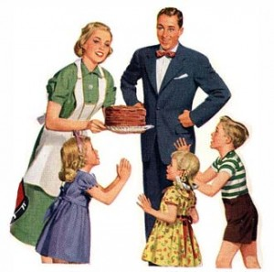
‘Traditional’ Family

Slide 3
‘Non-traditional’ family

Slide 4
FAMILY LIFE THAT IS FRACTURED MOSTLY BY:
Lack of Belief in Higher Power means failure to thrive when ‘hard times’ come. Family can and will let one down. It is good to believe in Family—but it is wise to believe in God!
Poverty of Belonging which originates from an uncertain commitment to the members. Many families have nothing in common, not a speck of loyalty and little care of the clan or name. And I think this is a crying shame.
Neglect of Interpersonal Nurturance
Provocative Anger/Wrath or Apathy devastates families. When family cannot ask for forgiveness, then living in family is hell!
Abuse of Soul occurs by emotional, mental, physical, sexual and spiritual violation. These things rend the psychic; body and core self; rendering all manner of disease.

Slide 5
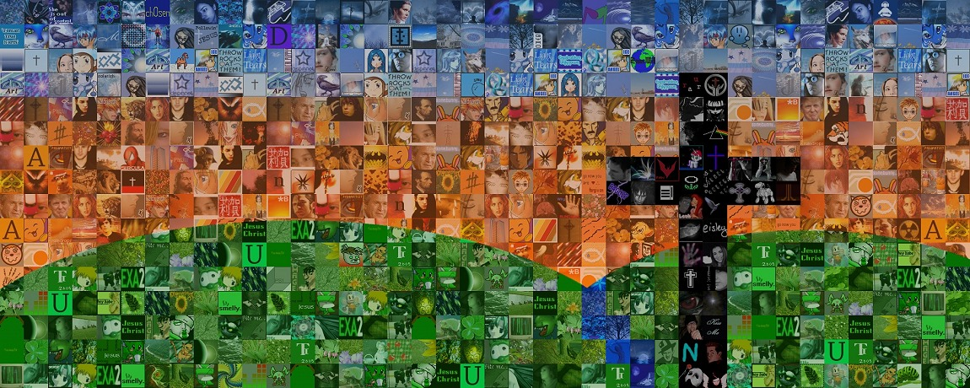
The Spirit Himself testifies with our spirit that we are God’s children. Now since we are children, then we are heirs—heirs of God and co-heirs with Christ.
Romans 8:16

Slide 7
