Slide 2
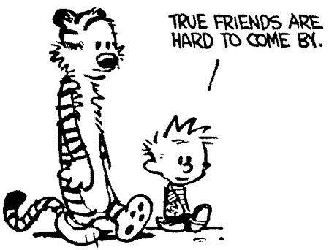

Slide 3
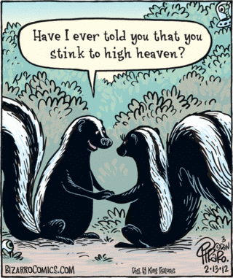

Slide 4
To Make A Friend
Be available
Offer a token
Get Provocative
How To Keep A Friend
Keep Confidences
Stay Loyal
Make Your Friends a Priority
Understand What Being a Friend Means

Slide 5
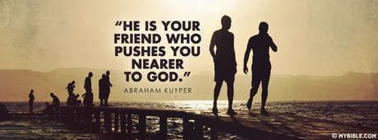

Slide 6
