Slide 2
We Live in an Unsafe World

Slide 4
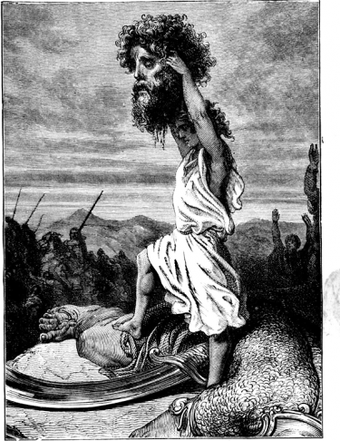
This day the Lord will deliver you into my hands.

Slide 5
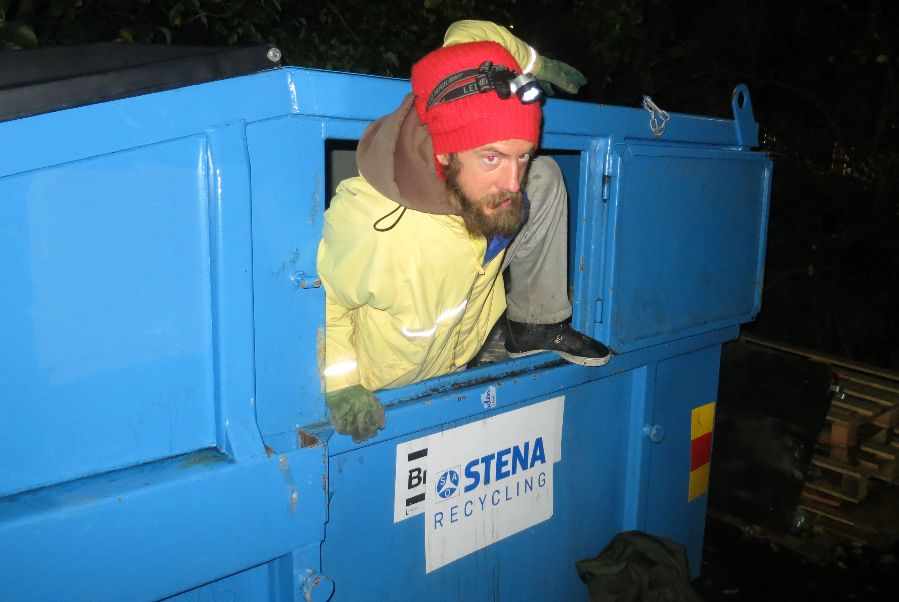
“But godliness actually is a means of great gain when accompanied by contentment. For we have brought nothing into
the world, so we cannot take anything out of it either. If we have food and covering, with these we shall be content.”
I Timothy 6:6-8

Slide 6
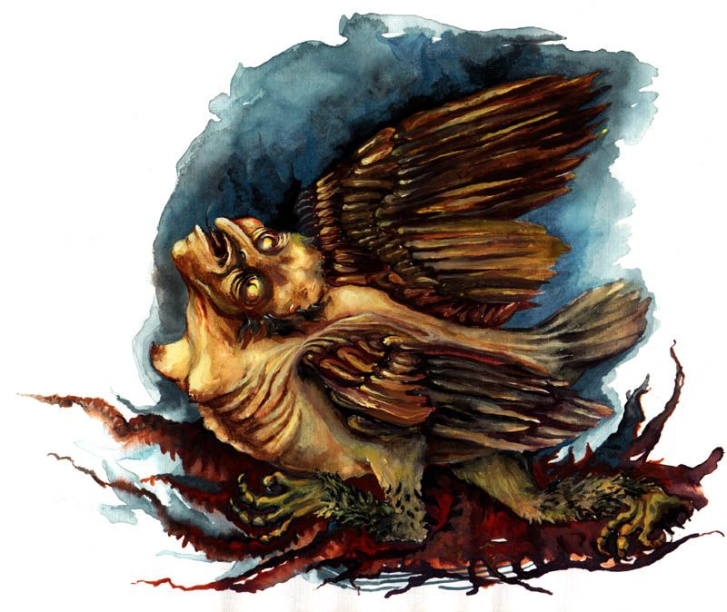
Allow me to give a small measure to
abate our fear of the unknown to keep us
safe from the boogie men and harpies.
Believe it will work out (whatever it is). declares “And we know that God works together all things for good to those loving God, to those being called according to His purpose.” (Romans 8:28)
Keep the mind in the present. “We are overthrowing arguments, and every high thing lifting itself up against the knowledge of God, and taking captive every thought into the obedience of Christ.” (2 Corinthians 10:5)
Remember the One who Overcame the Lies. “I have told you these things, so that in me you may have peace. In this world you will have trouble. But take heart! I have overcome the world.” (John 16:33)

Slide 7
We can live above fear.
Live in Faith

