Slide 2
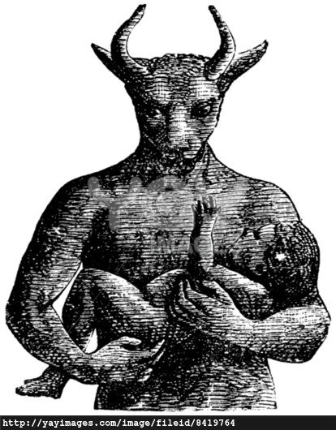
“And the children of Israel did evil in the sight of the Lord, and served Baalim: and they forsook the Lord, and served Baal and Ashtoreth.” (Judges 2:11, 13)

Slide 3
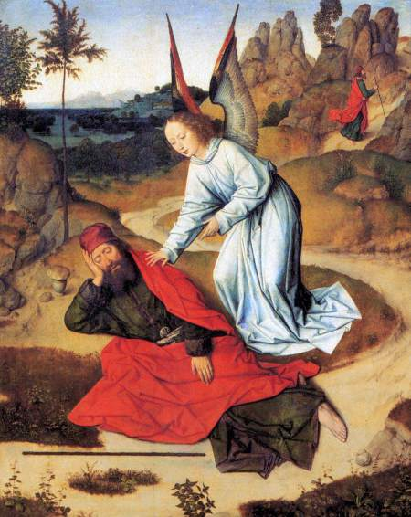

Slide 5
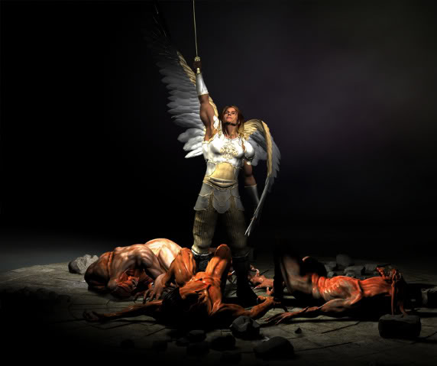
“And from the days of John the Baptist until now the kingdom of God suffers violence, and the violent take it by force. For all the prophets and the law prophesied until John. And if you will receive it, this is Elijah, which was for to come” (Matt 11:12-24)

Slide 6
(I Tim 6:12a) “Fight the good fight of faith; seize eternal life, whereunto you are also called.”

Slide 7
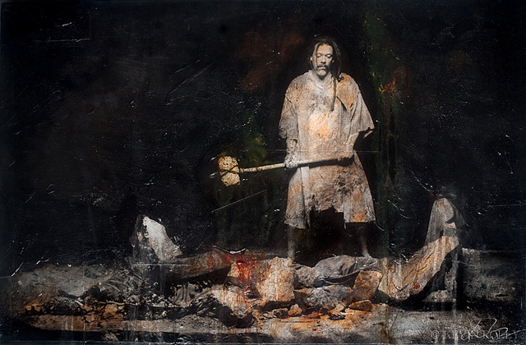
(2 Kings 10:26-27) “And they brought out the pillar of the house of the Baal and burned them. And they pulled down the pillar of the Baal and pulled down the house of the Baal and turned it into a latrine until this day."

