Slide 2
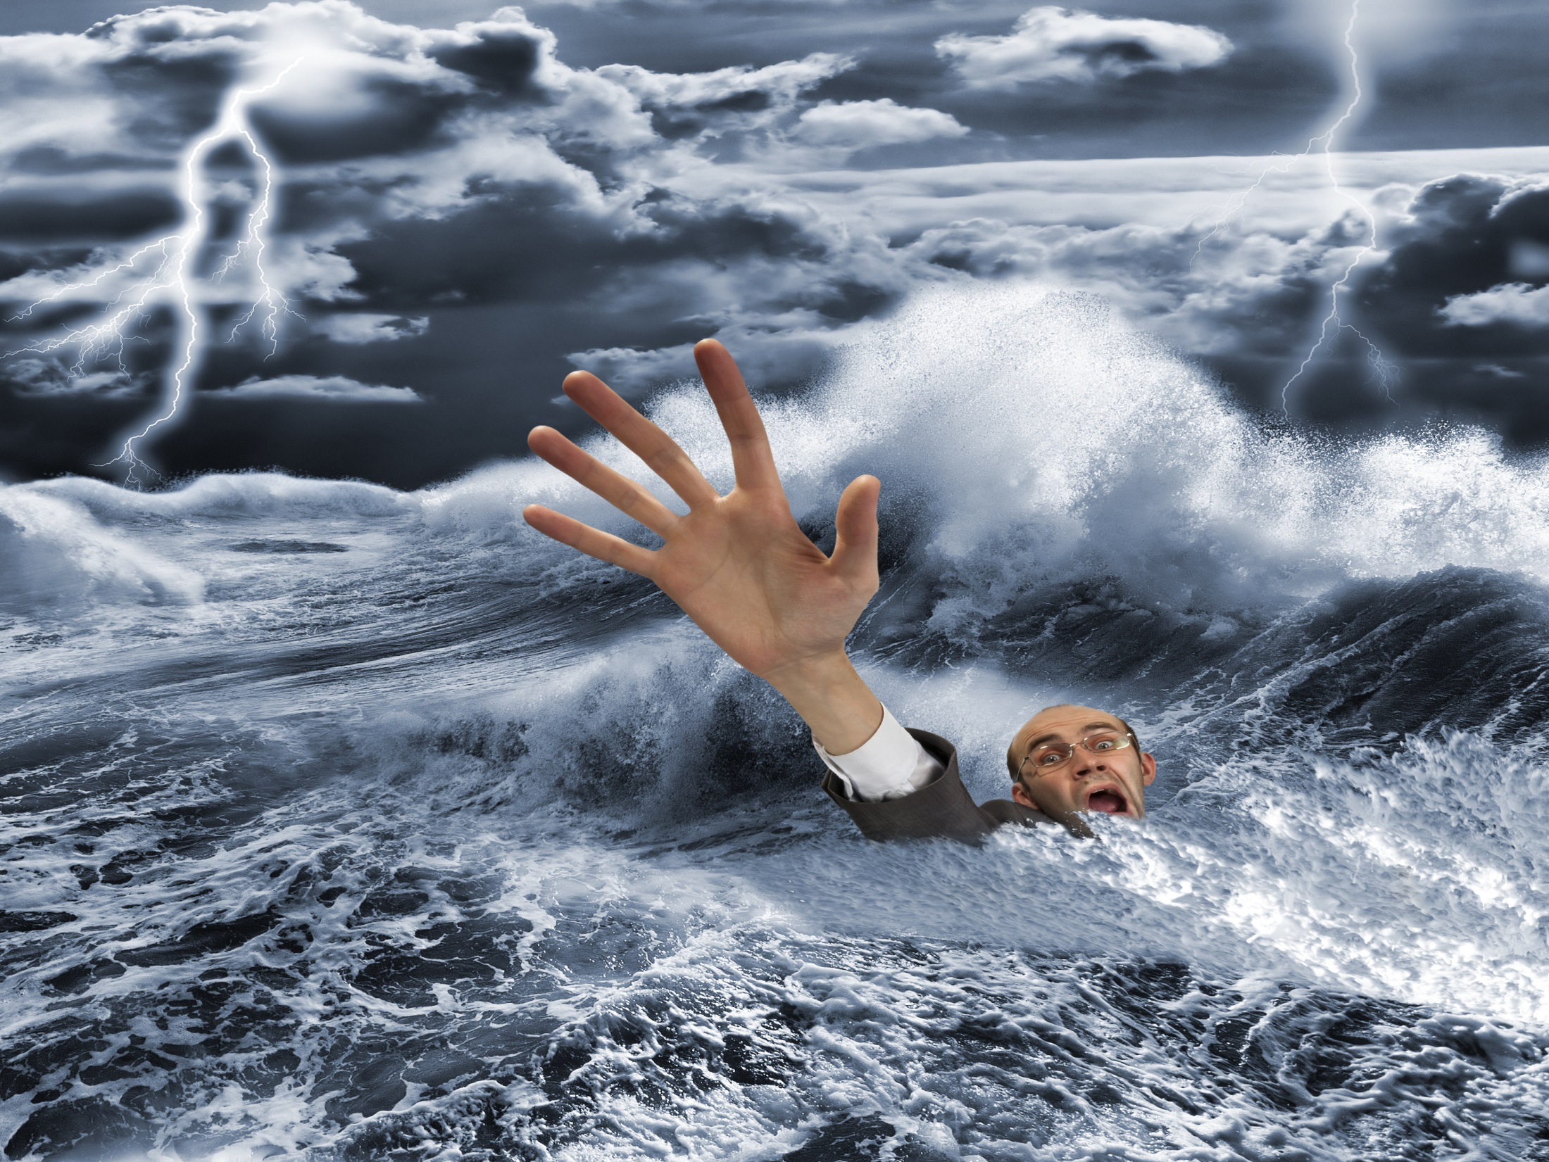

Slide 4
I have a few of the reasons why faith is lost.
Extreme, unrelenting tragedy
Poverty of the mind, body and spirit
Indifference to the human drama
Substance or behavioral addiction
Insistence upon violence

Slide 5
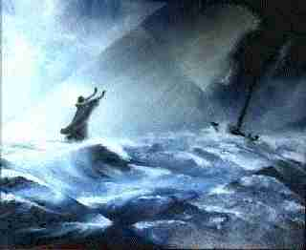
These conditions extinguish faith! Even so, all Christians and
Christians only have this promise from (2 Tim 2:13)
“If we are faithless, He remains faithful, for He is not able to deny Himself.”

Slide 6
What Jesus Christ did for Us in His faith that propelled
Him to be crucified deserves a similar response.
(2 Timothy 1:7) proclaims
“For God has not given us the spirit of fear;
but of power, and of love, and of a sound mind.”
When we come to our sanity and come
out of our faithlessness we are empowered by
the supernatural and unconditional love for The Faith! This means:
We let go of our attachments to people and things.
We surrender to Spirit.
We keep the faith.

