Slide 2
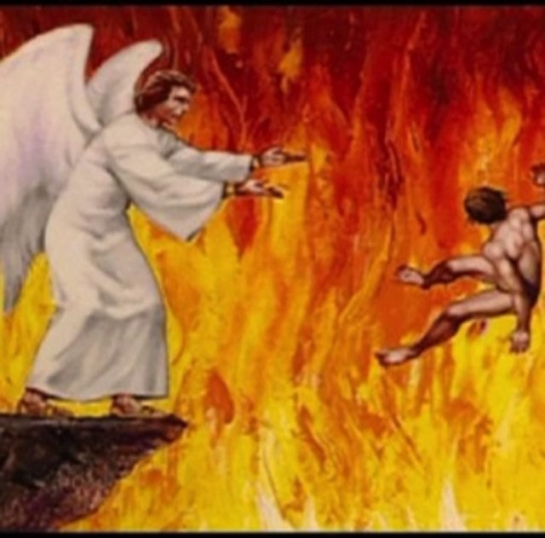
“Sinners in the Hands of an Angry God”

Slide 5
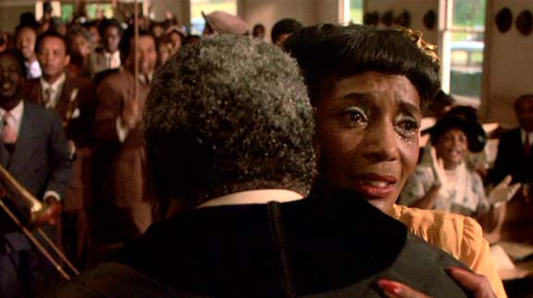

Slide 6
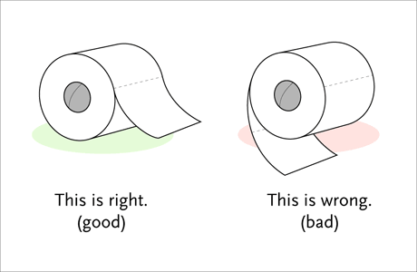
It’s simple really.
If it is wrong—don’t do it!
If it hurts another—don’t do it!
If it edifies the faith—do so!
If it is wholesome—partake freely!

