Slide 2
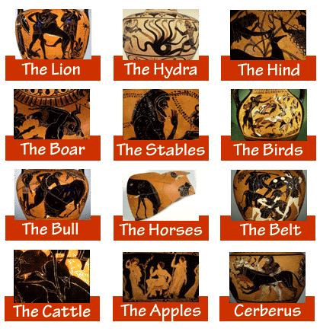

Slide 3
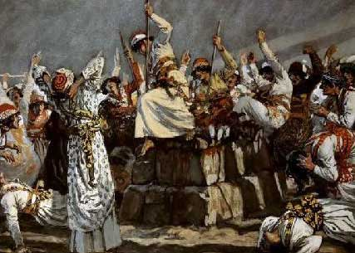
“O Baal, answer us!” they shouted. But there was no response; no one answered. And they danced around the altar they had made. At noon Elijah began to taunt them. “Shout louder!” he said. “Surely he is a god! Perhaps he is deep in thought, or busy, or traveling. Maybe he is sleeping and must be awakened. So they shouted louder and slashed themselves with swords and spears, as was their custom, until their blood flowed. Midday passed, and they continued their frantic prophesying until the time for the evening sacrifice. But there was no response, no one answered, no one paid attention.”

Slide 5
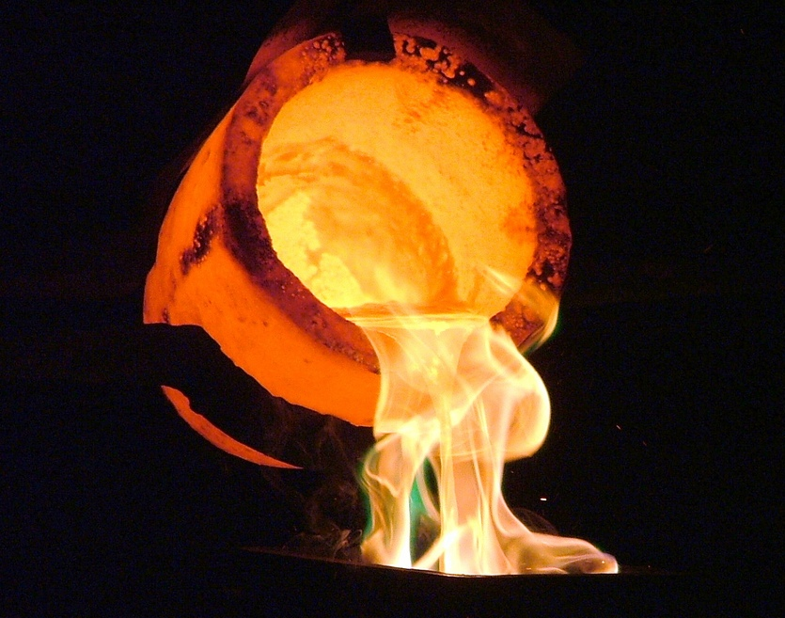
Our Father designed Us to be filled with the power from on High, regulated to strength and purified by a sacred
fire, wondrous to behold, as we are being forged by the giggles and grins of the Celestials. That is the reason
for the verses about having joy and staying calm in torment and pain!
By a grand design we are to overcome!

Slide 6
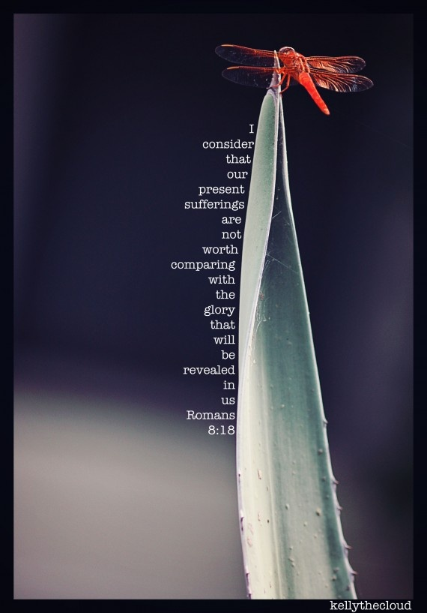

Slide 7
Before Us are herculean tasks:
to ignore the toothless lion (I Peter 5:8)
refuse the temptations of the seven deadly sins, (Proverbs 6:16-19)
resist the devil, (James 4:7)
capture our impure thoughts, (2 Corinthians 10:5)
put away our old lifestyles, (Ephesians 4:22)
reign in our appetites, (I Corinthians 6:12)
never fear death, (I Corinthians 15:55)
wear proudly the girdle of our salvation, (Ephesians 6:14)
spit in the eye of the Serpent, (Revelations 20:20)
never quench the Spirit, (I Thessalonians 5:19) and
cleanse our flesh and Spirit (II Corinthians 7:1) every single day!
All of this and more is possible: for with God, nothing is impossible!
(Mark 10:27)

Slide 8
