Slide 2
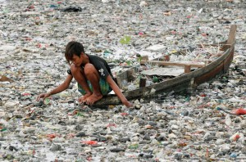

Slide 3
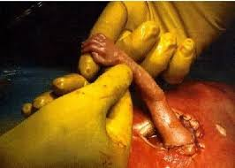
(Ephesians 2:10) declares, “For we are God’s handiwork, created in Christ Jesus

Slide 4
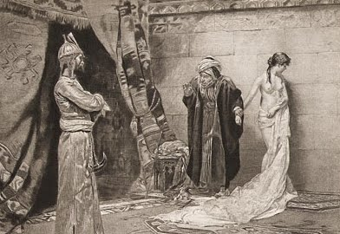
XXXX

Slide 5
One ‘radiant church, without stain or wrinkle or any other blemish, but holy and blameless.
Ephesians 5:27

Slide 6
There are three meanings of this word “RADIANT”
sending out light; shining or glowing brightly, shining, illuminated, gleaming, shimmering, resplendent
(of heat) transmitted by radiation, rather than conduction or convection.
a point or object from which light or heat radiates, especially a heating element in an electric or gas heater.

Slide 7
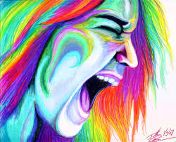
Let Us shut out our colors!

