Slide 3
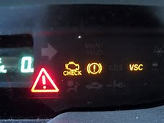

Slide 6
I have been crucified with Christ; it is no longer I who live, but Christ lives in me; and the life which I now live in the flesh I live by faith in the Son of God, who loved me and gave Himself for me.
Galatians 2:20

Slide 7
Be anxious for nothing, but in everything by prayer and supplication, with thanksgiving, let your requests be made known to God; and the peace of God, which surpasses all understanding, will guard your hearts and minds through Christ Jesus.
Phillipians 4:6-7

Slide 8
