Slide 2
“Out Loud”

Slide 3
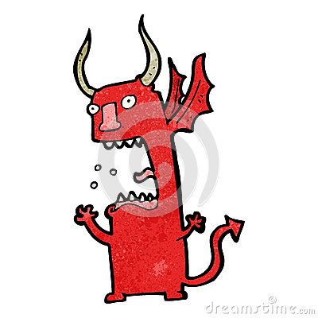
When the Devil is shouting “NO WAY!” Get Ready! The WAY is about to show UP! Jerry Savelle

Slide 4
“Let his loyalty and devotion be a lesson to us all."

Slide 7
